Slide 1
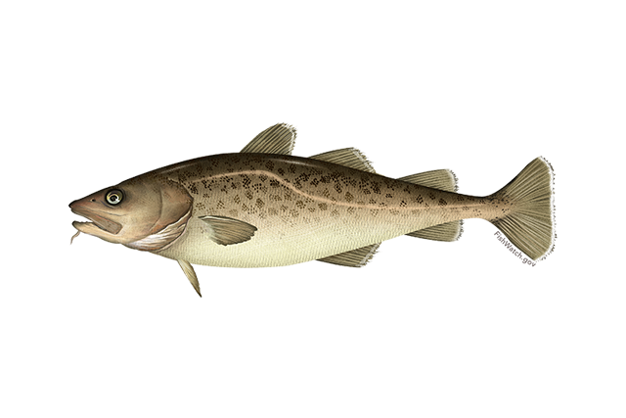

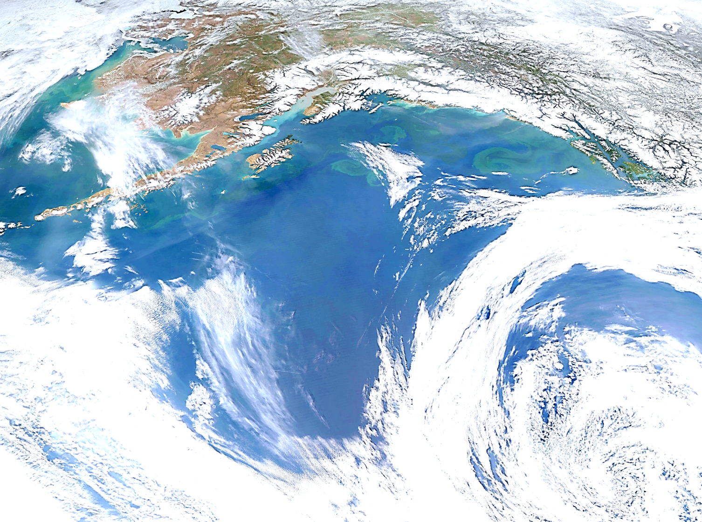


Goa pacific cod
P. hulson, s. barbeaux, b. ferriss, k. echave, J. Nielsen, S. McDermott, b. laurel, a. abookire, Ingrid spies, and s. k. shotwell
January 2026, Presentation to the GOA Plan Team

Slide 2
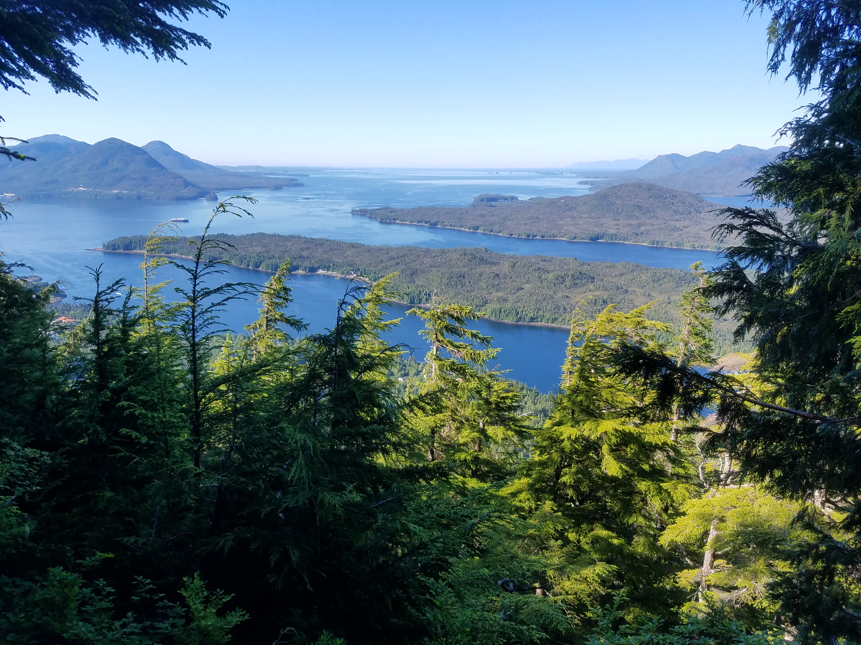
Assessment overview
BLUF:
GOA Pacific cod: Tier 3b
2025 estimated spawning biomass to be at B_{34.3%}, projected in 2026 to be at B_{33.1%}
2026 recommended ABC is a 29% increase from 2025 ABC
Do not recommend reduction from maximum ABC

Slide 3
Operational Update assessment
2025 GOA Pacific cod is an ‘Operational Update’ assessment:
“An operational update assessment is conducted when updating the last full assessment model structure with current data, and maintains the accepted model configuration. This assessment type must carry forward the fundamental structure of the last operational full assessment reviewed and endorsed through the NPFMC review process. Therefore, the content presented in an operational update assessment can be considered an abbreviated version of the last operational full assessment, and the majority of sections that do not directly inform review bodies on making a management decision can be presented in a condensed form and referenced from the last operational full assessment.” – Alaska Groundfish Stock Assessment Guidelines
Distinct from an ‘Operational Full’ assessment within which alternative models are explored and recommended

Slide 4
Operational Update assessment
2025 GOA Pacific cod is an ‘Operational Update’ assessment:
Only new data through 2025 included, no model changes
Abbreviated SAFE document
Only sections that have been updated with new information since 2024 assessment included
Any missing sections (e.g., full Introduction) can be found in the 2024 SAFE
SSC/PT comments and responses not included, will be included and addressed in the next full assessment
Additional model files, results, and diagnostics area available electronically at this link

Slide 5

Assessment evaluation Outline
Data
Fishery
Results
Data fit
Recs
Risk Table
Survey
Other
Model evaluation
Model estimates
ABC/OFL
BRD

Slide 6

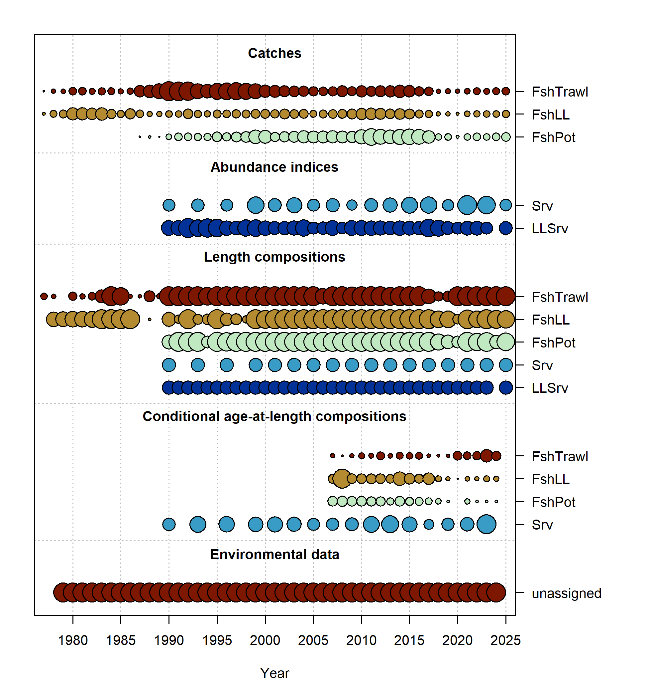
Data overview
New Data | Years
Federal and state fishery catch, by gear type | 2024, 2025
Federal and state fishery length composition, by gear type | 2024, 2025
Federal fishery conditional age-at-length | 2024
GOA AFSC bottom trawl survey abundance | 2025
GOA AFSC bottom trawl survey length composition | 2025
GOA AFSC longline survey Relative Population Numbers | 2025
GOA AFSC longline survey length composition | 2025

Slide 7
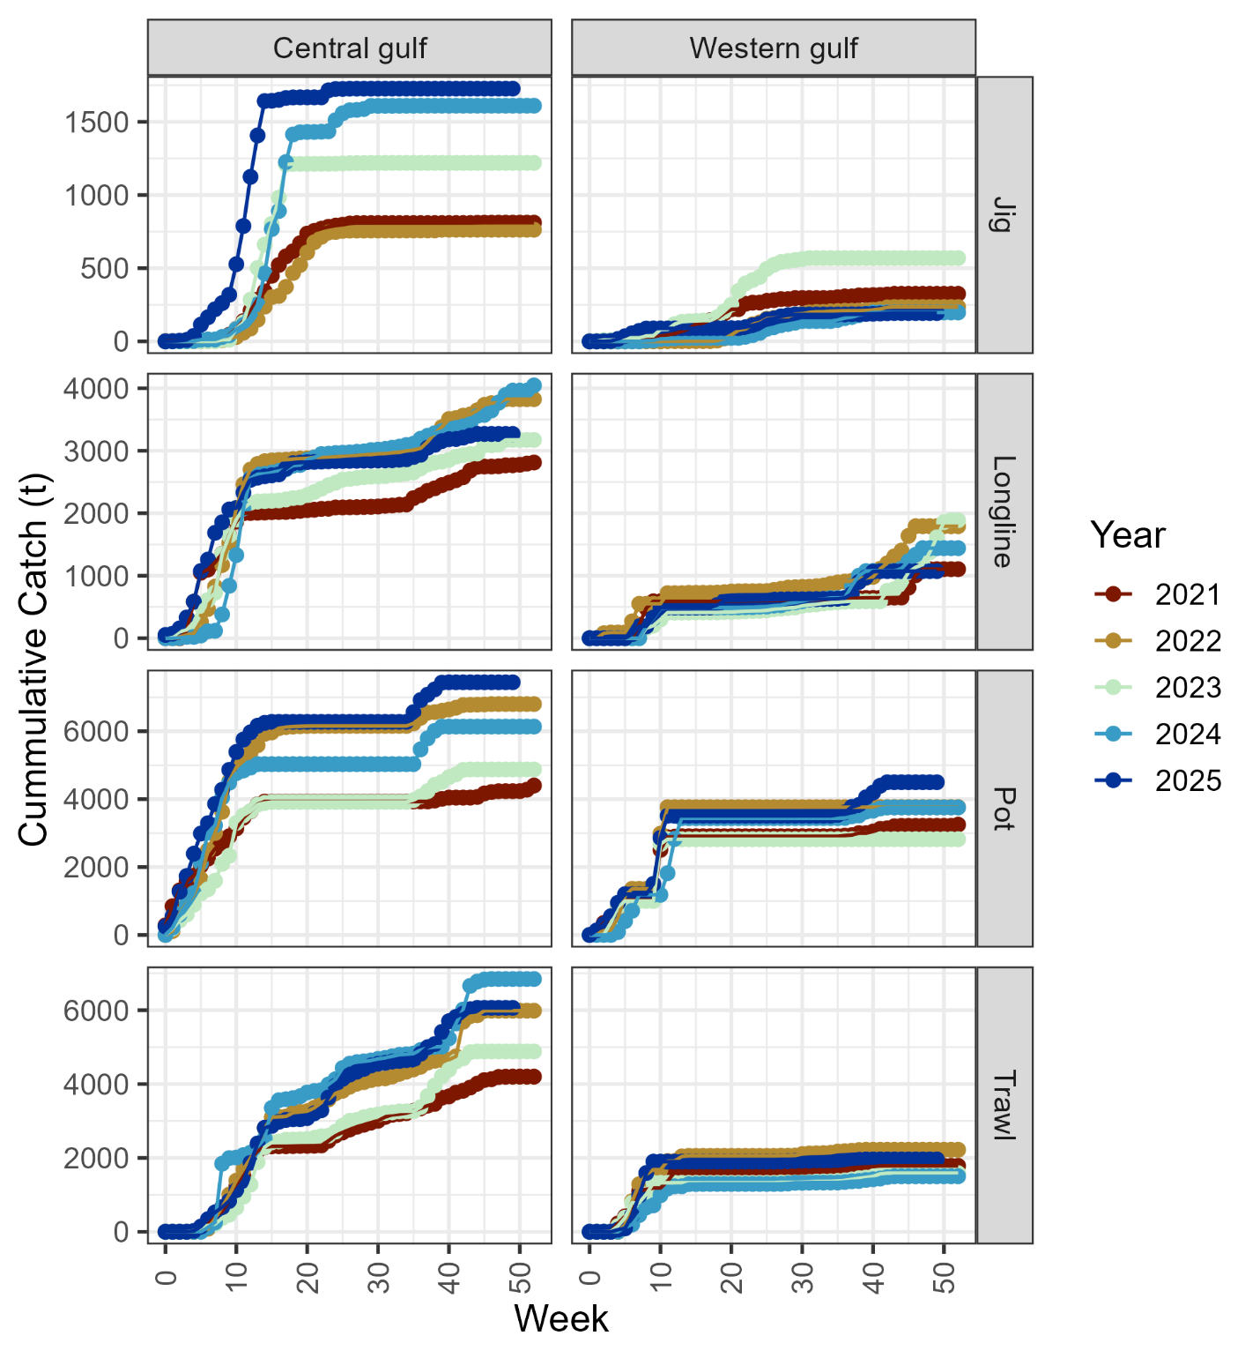
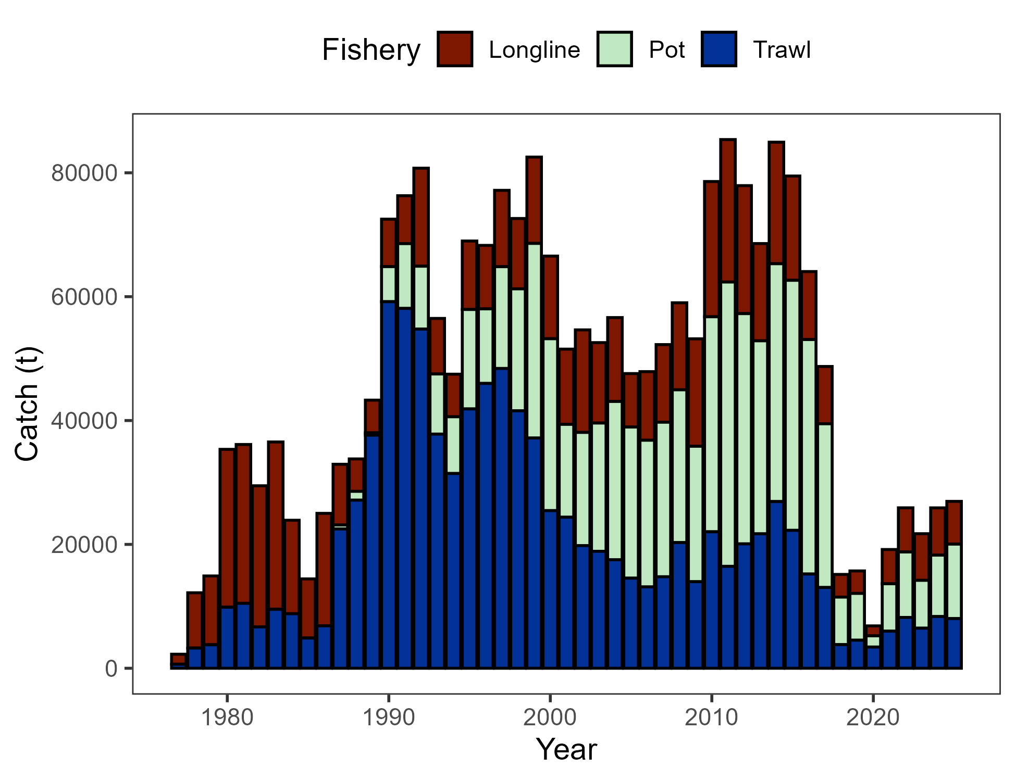
Data - Catch
Pot majority > LL > Trawl
Nothing inconsistent in cumulative catch to previous years
Catch through Dec 8, 2025

Slide 8
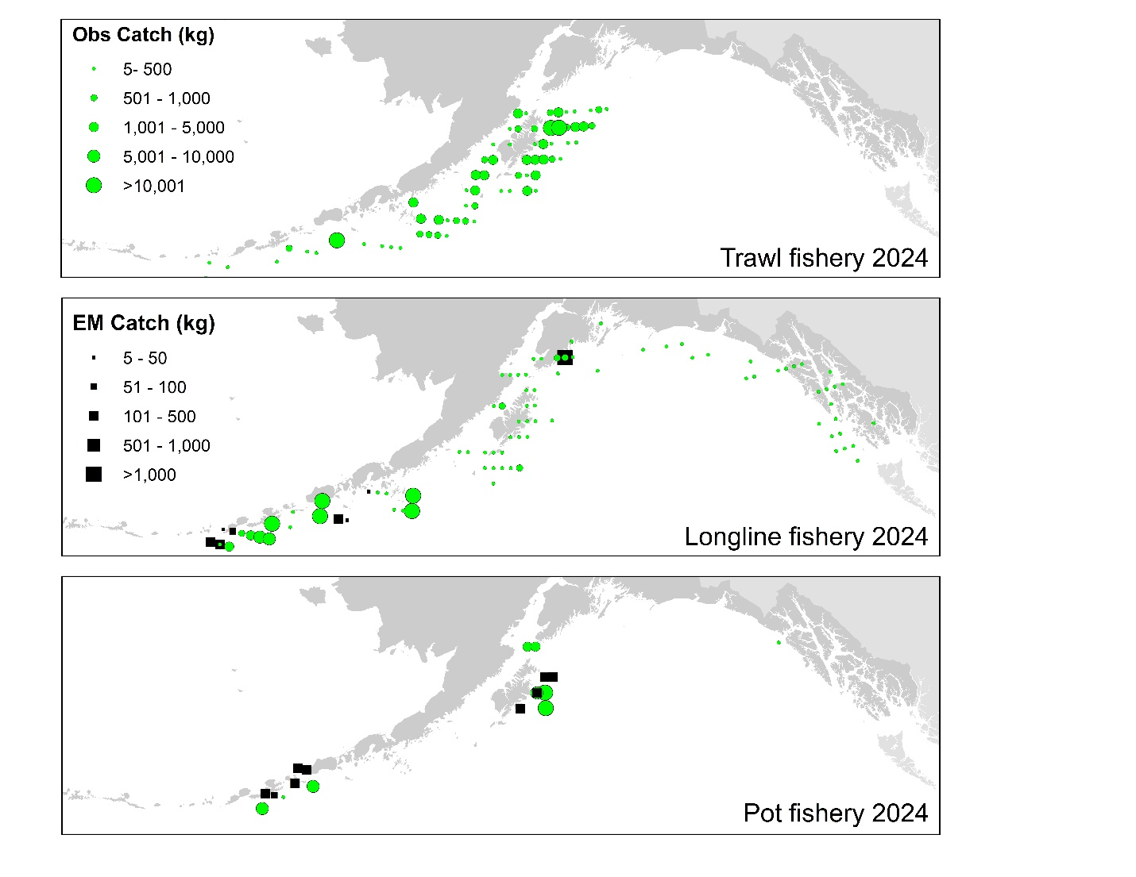
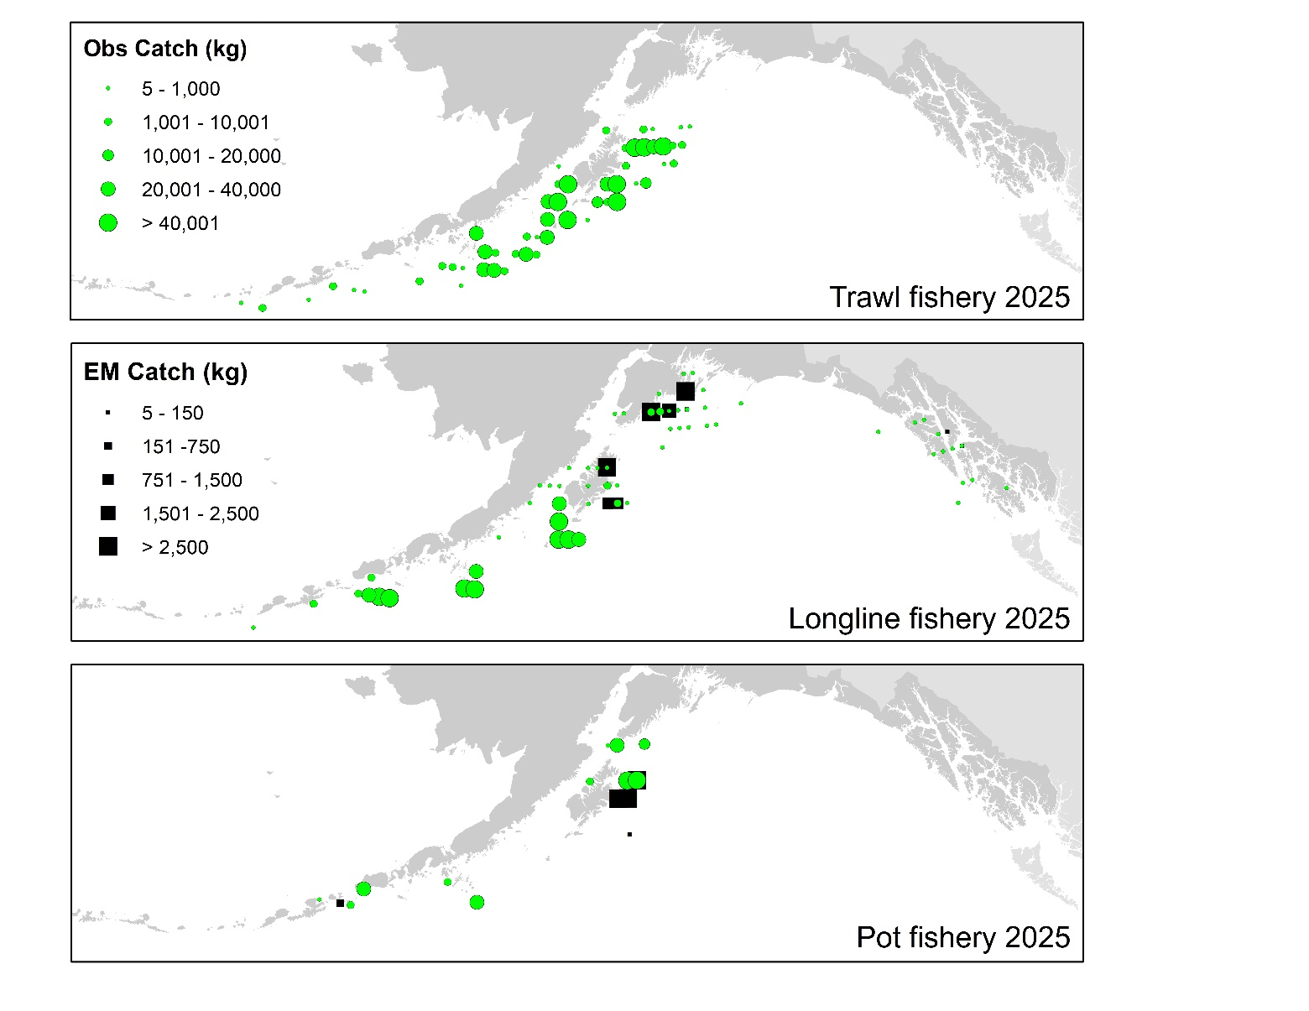
Data – Catch distribution
2025 distribution similar to previous catch distribution
For how much relative catch is taken by pot, small # observed hauls

Slide 9
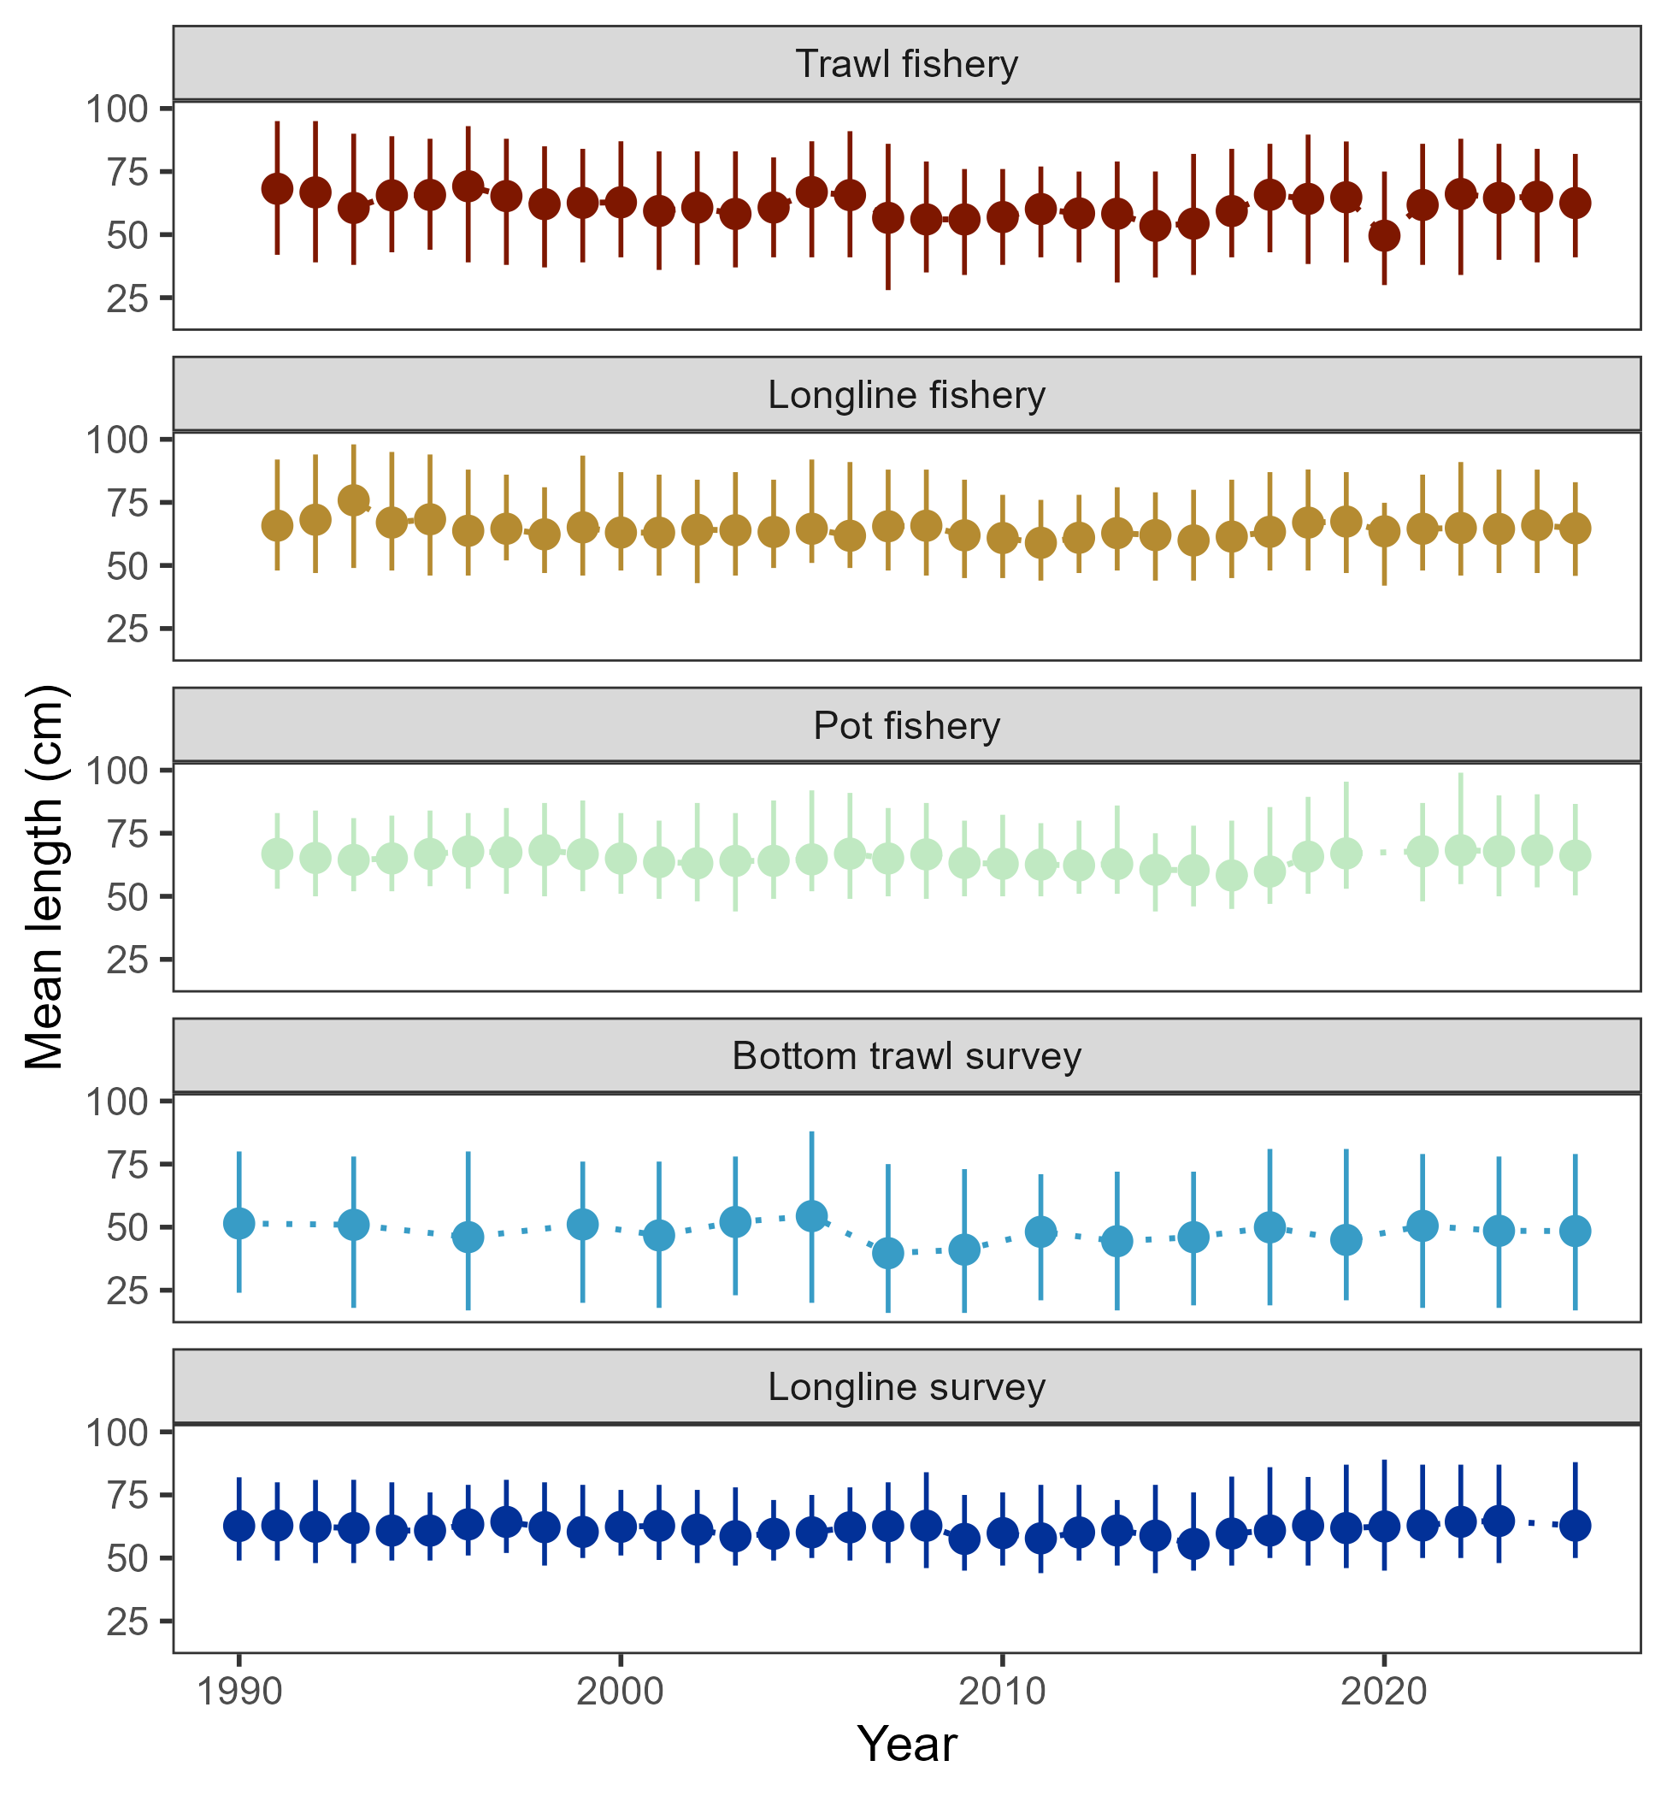
Data – length comps
In general, mean length in 2024 similar to that in previous 4 or so years

Slide 10
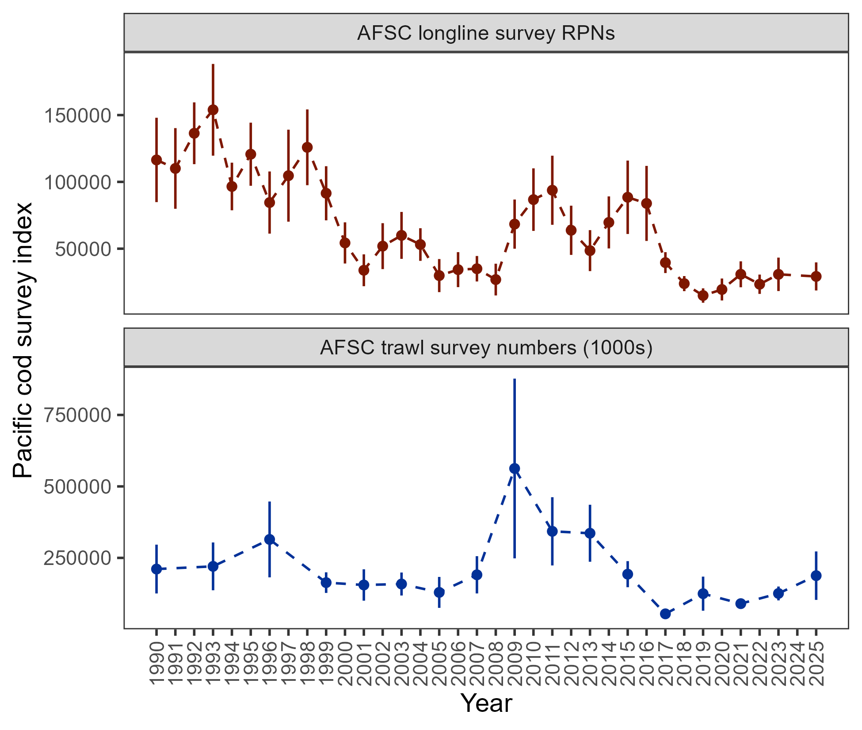
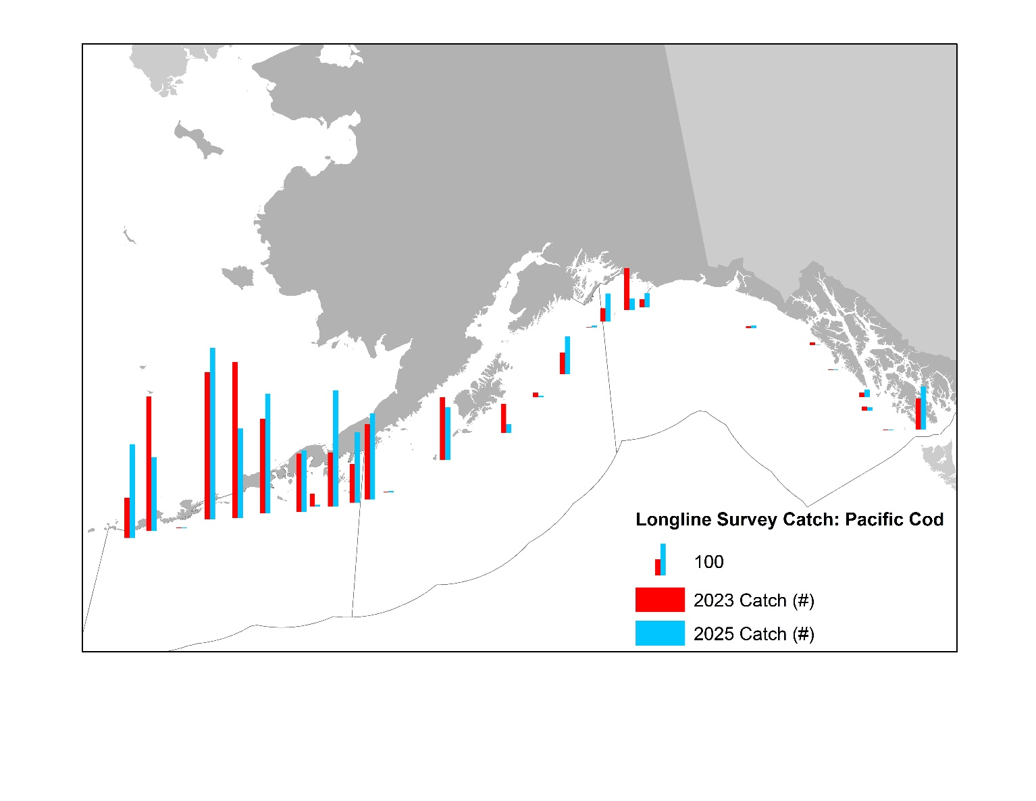
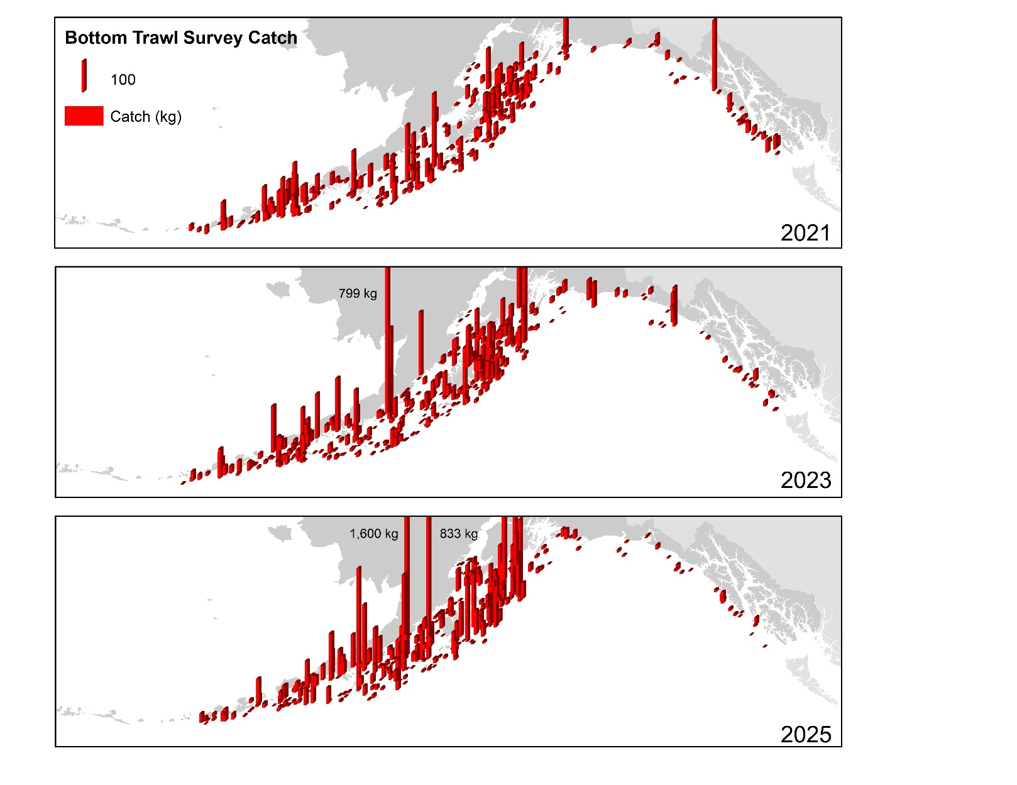
Data – afsc surveys
-5%
+49.6%

Slide 11
Data – afsc surveys
Adding context to the survey results:
Why was there an observed decline in longline survey RPNs that is inconsistent with trawl survey abundance?
Was there an influence of the GOA bottom trawl survey restratification on 2025 results?

Slide 12
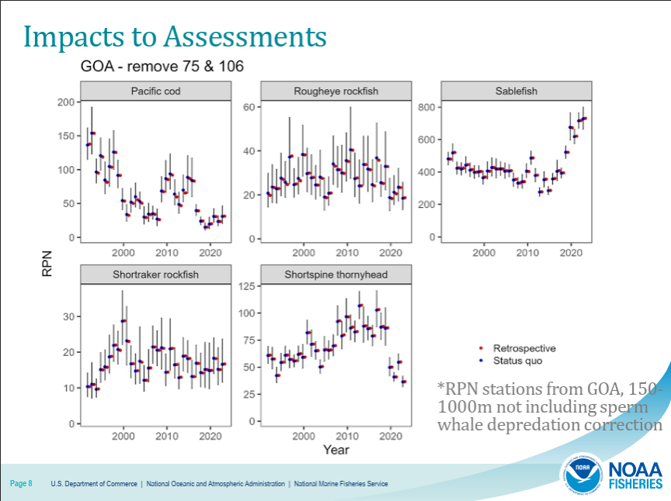
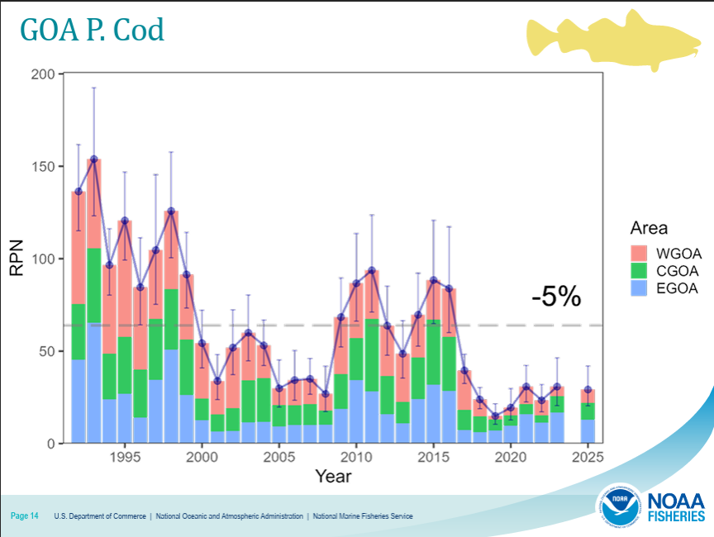
Data – afsc surveys
Why was there an observed decline in longline survey RPNs?
Not due to dropping stations in survey redesign
Subregion change since 2023: WGOA +40%, CGOA +4.8%, EGOA -23.6%
This decline in GOA-wide RPN due to EGOA

Slide 13
Data – afsc surveys
Why was there an observed decline in longline survey RPNs?
RPN calculation reminder: mean catch per hook (across skates within a strata) multiplied by stratum area size (stratum are 150m and deeper)
Drilling down into EGOA:
Why is the EGOA RPN so large in comparison to WGOA and CGOA?
What was the reason for the EGOA RPN decline?

Slide 14
Data – afsc surveys
Drilling down into EGOA RPN: Why so large?
Since 2020 77% of cod in RPN index caught in 151-200m stratum (remainder caught in 201-300m stratum; note: 1.3x more cod caught in 101-150m compared to 151-200m)
Area size for 151-200m in EGOA 4x larger than WGOA and 3x larger than CGOA
Large area size has downstream effect on RPN resulting in >33% of GOA RPN within EGOA across time-series (AFSC bottom trawl survey observes <5% of cod abundance in EGOA)

Slide 15
Data – afsc surveys
Drilling down into EGOA:
Compared to 2023, only one station’s catch of cod declined
#90: 2023 catch largest since 1993, 6.5x larger than avg since 2000
Bottom line: a single station from a subregion with disproportionate area size drove the decline in the RPN index
The RPN index is not wrong, this is a result of the particular stratums we use for this index (which were originally designed with sablefish in mind)

Slide 16
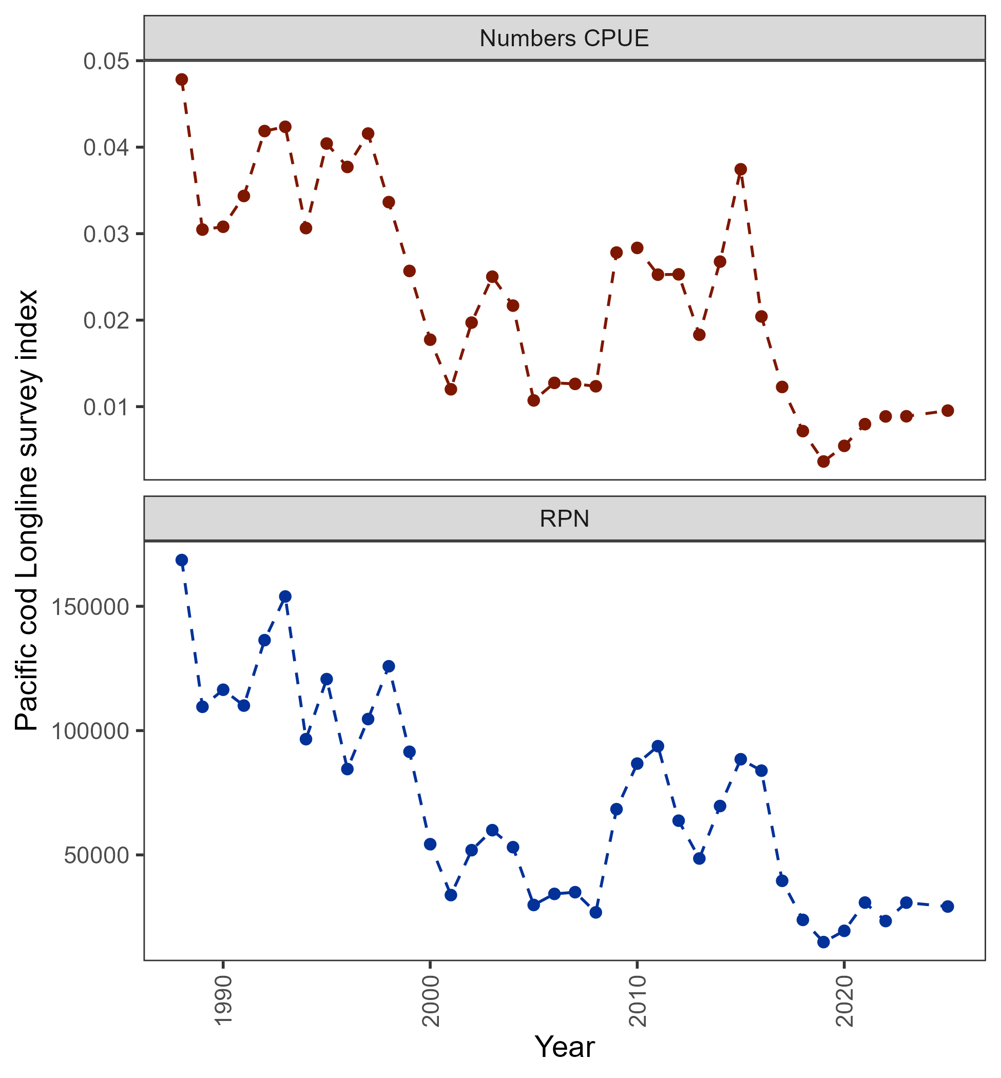
Data – afsc surveys
Taking out area size effect and looking at numbers CPUE:
While 5% decrease in RPN index GOA-wide, numbers CPUE increased by more than 7% (even when still including station 90)
+7.4%
-5%

Slide 17
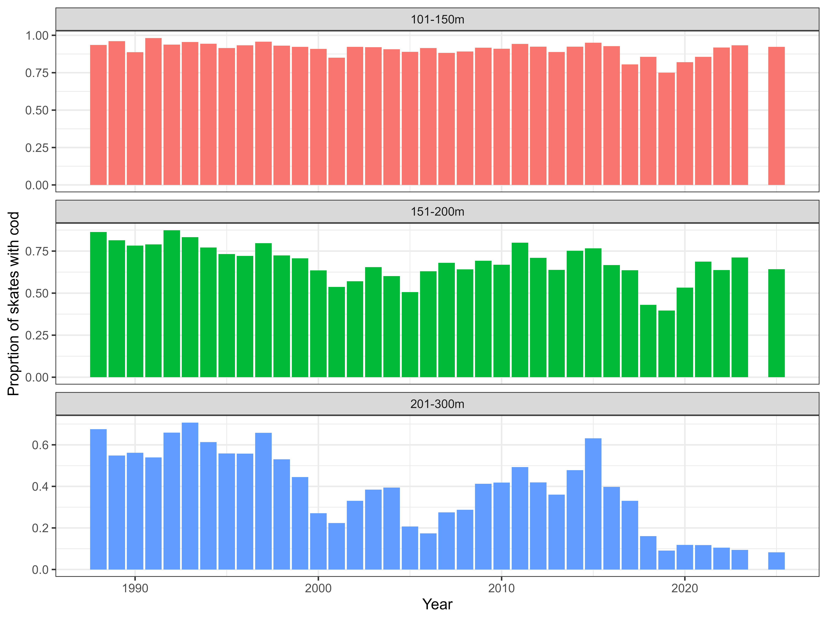
Data – afsc surveys
Prior to next full assessment we will be reevaluating how AFSC longline survey RPN index computed
Update assessment: did not change the index used in the model

Slide 18
Data – afsc surveys
Was there an influence of the GOA bottom trawl survey restratification on 2025 results?
Reminder: over the years PT/SSC has reviewed several presentations leading up to application in 2025 of GOA survey redesign, design has been extensively simulation tested
Final piece: using real data, what would happen if historical data collected following new survey design?
Appendix 2.2: with GAP (Zack Oyafuso and Stan Kotwicki) performed analysis in which historical stations were post-stratified into 2025 strata for GOA cod

Slide 19
Data – afsc surveys
Using real data, what would happen if historical data collected following new survey design?
Not a straight-forward question, main problem to overcome is that historical stations were chosen within a grid cell with selection probabilities based on old strata
Thought experiment: if we are selecting 10 grid cells randomly within a strata that has 100 grid cells, each grid cell has 1/10 chance of being selected, or, a 0.1 selection probability

Slide 20
Data – afsc surveys
Thinking about one of those selected grid cells in the original design, under restratification it may find itself in a strata that has 150 grid cells. Under the new design the selection probability would be different than the original 0.1
Upon post-stratification within new strata, before you calculate design-based indices, you must re-weight to account for the new selection probabilities, otherwise you will introduce bias

Slide 21
Data – afsc surveys
Using real data, what would happen if historical data collected following new survey design?
Utilized survey R-package “Analysis of complex survey samples”
survey::postStratify() function follows Rao et al (2002 – analyzing survey data using poststratification) with variance estimates following Valliant (1993)
Steps taken in analysis:
Reclassified historical stations within new 2025 stratum boundaries
Post-stratified and re-weighted station observations
Compute design-based index

Slide 22
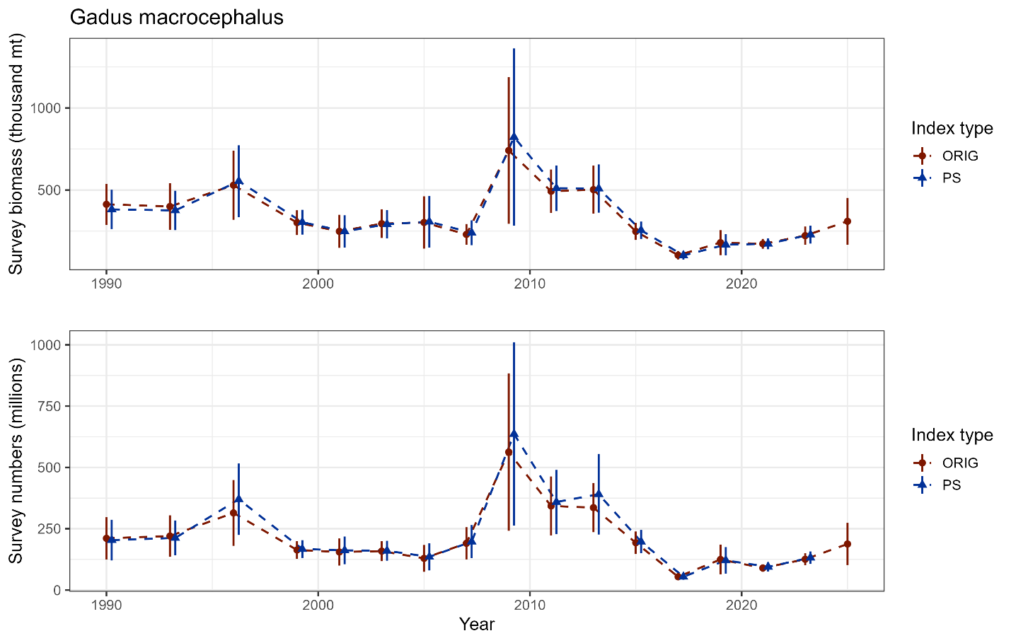
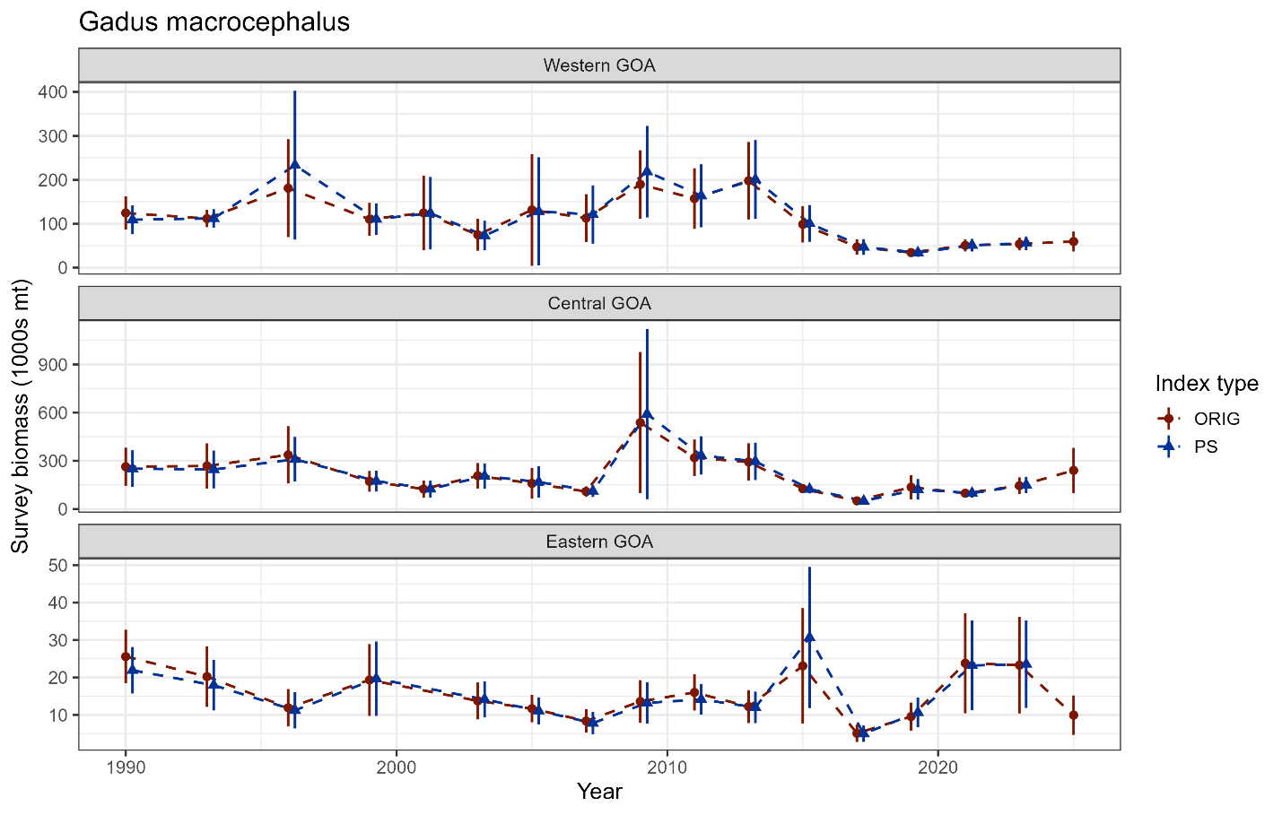
Data – afsc surveys
Results indicate minor differences between time-series, particularly since 2019
CVs increase by 0.6% for biomass, 1.4% for numbers, on average

Slide 23
Data – afsc surveys
Was there an influence of the GOA bottom trawl survey restratification on 2025 results? NO
The results from the 2025 survey continue trends we have recently observed and estimates that are within historical ranges
This analysis was not intended to create a new time-series of historical data, rather, to compare and verify that the 2025 survey restratification did not have an unintended consequence on historical data
GOA cod is one of best test cases, impossible to disentangle effects of post-stratification with sampling variability for stocks that are more difficult to sample (i.e., rockfish)

Slide 24
Data – afsc surveys
2025 AFSC bottom trawl survey index (biomass and numbers) associated with 23% CV
Increase in catch variable across stations
Number of stations in 2025 fewest in survey since 1990

Slide 25
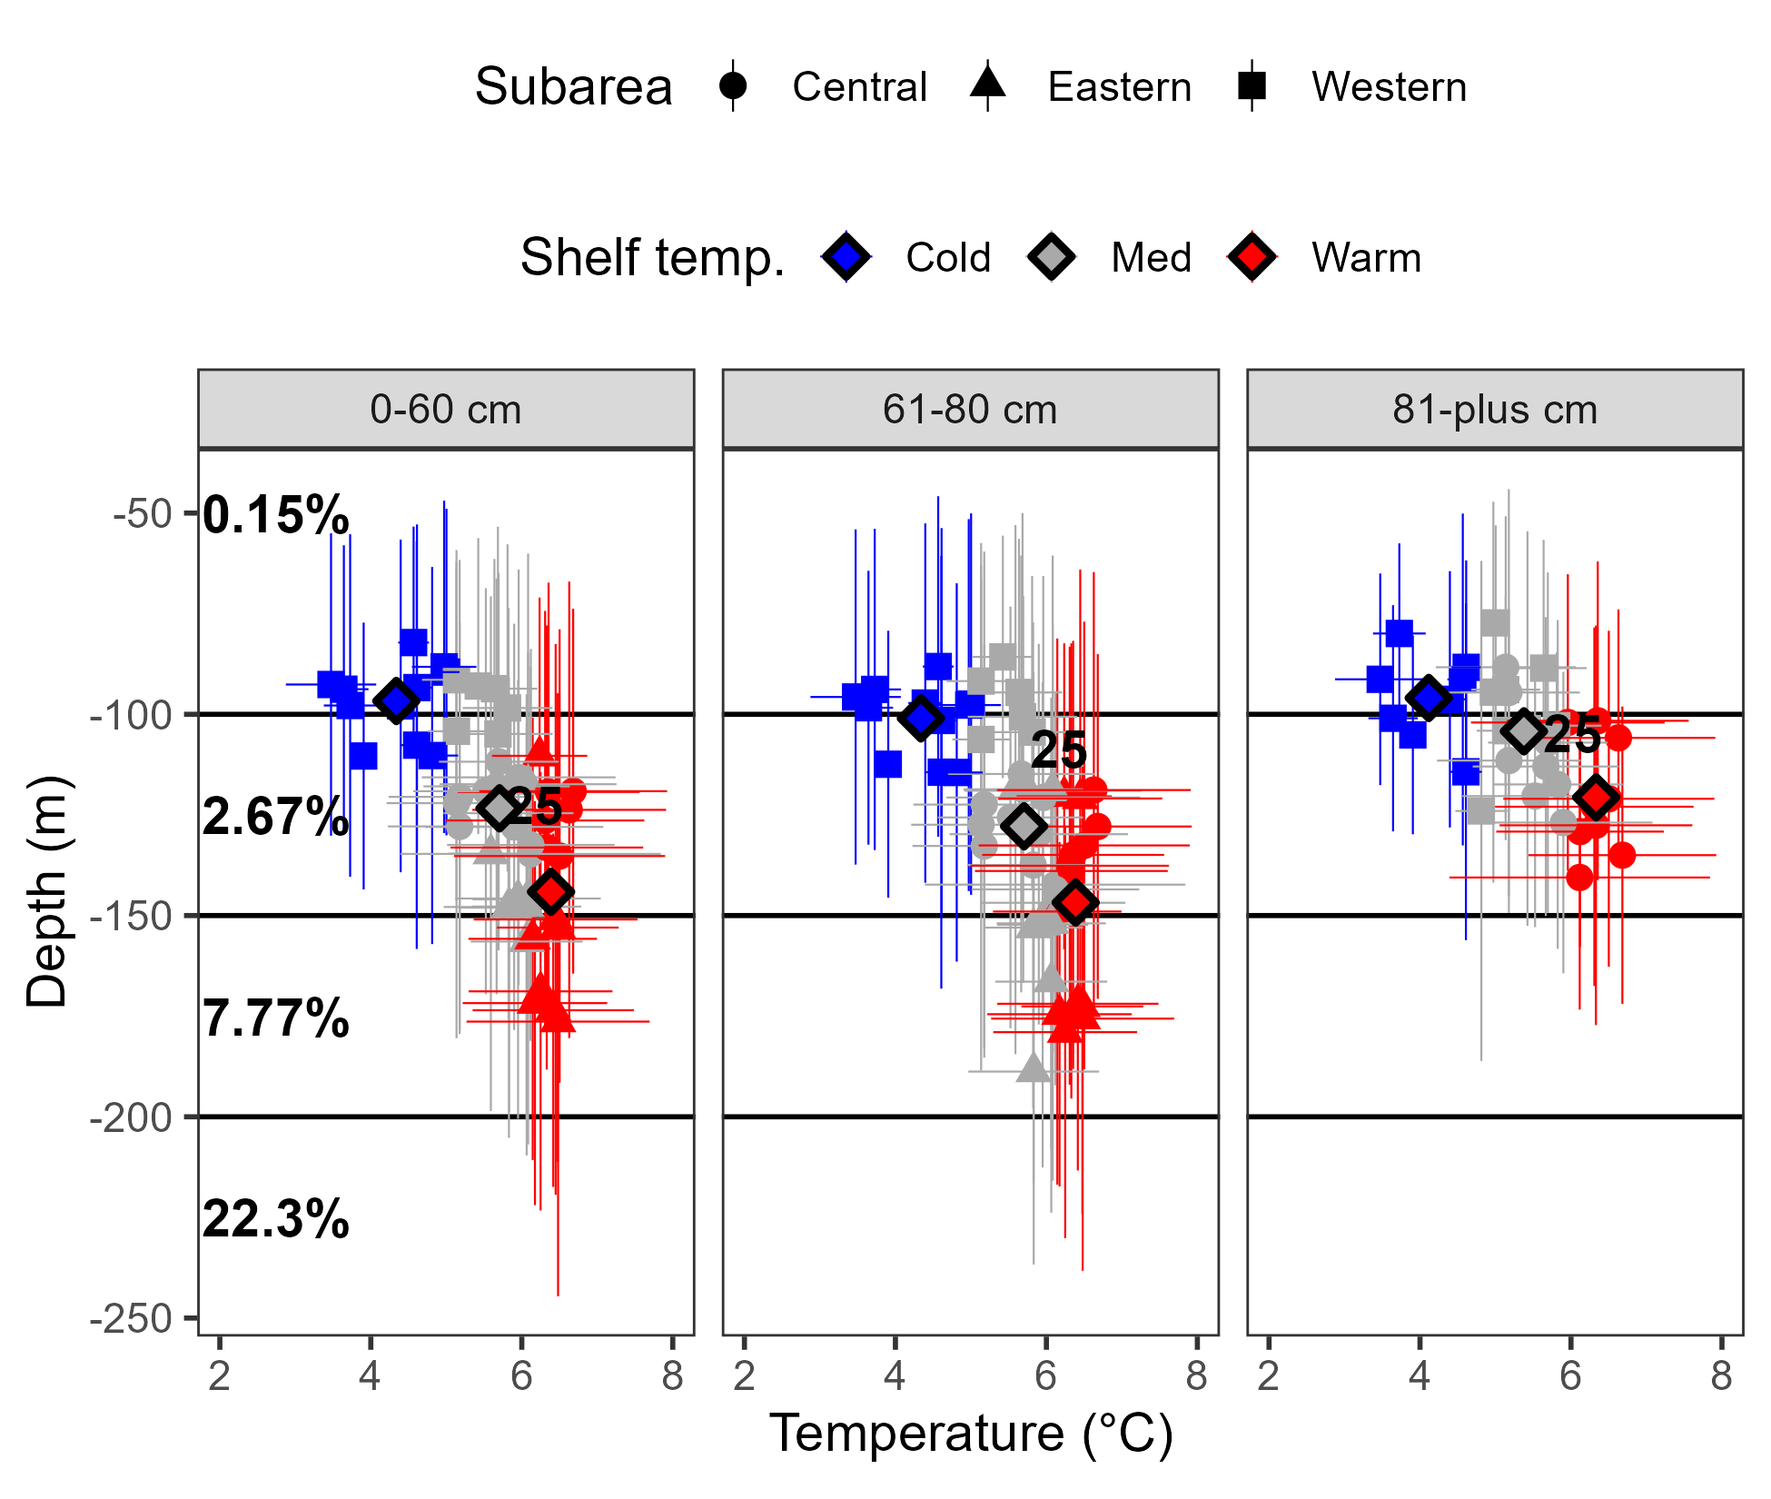
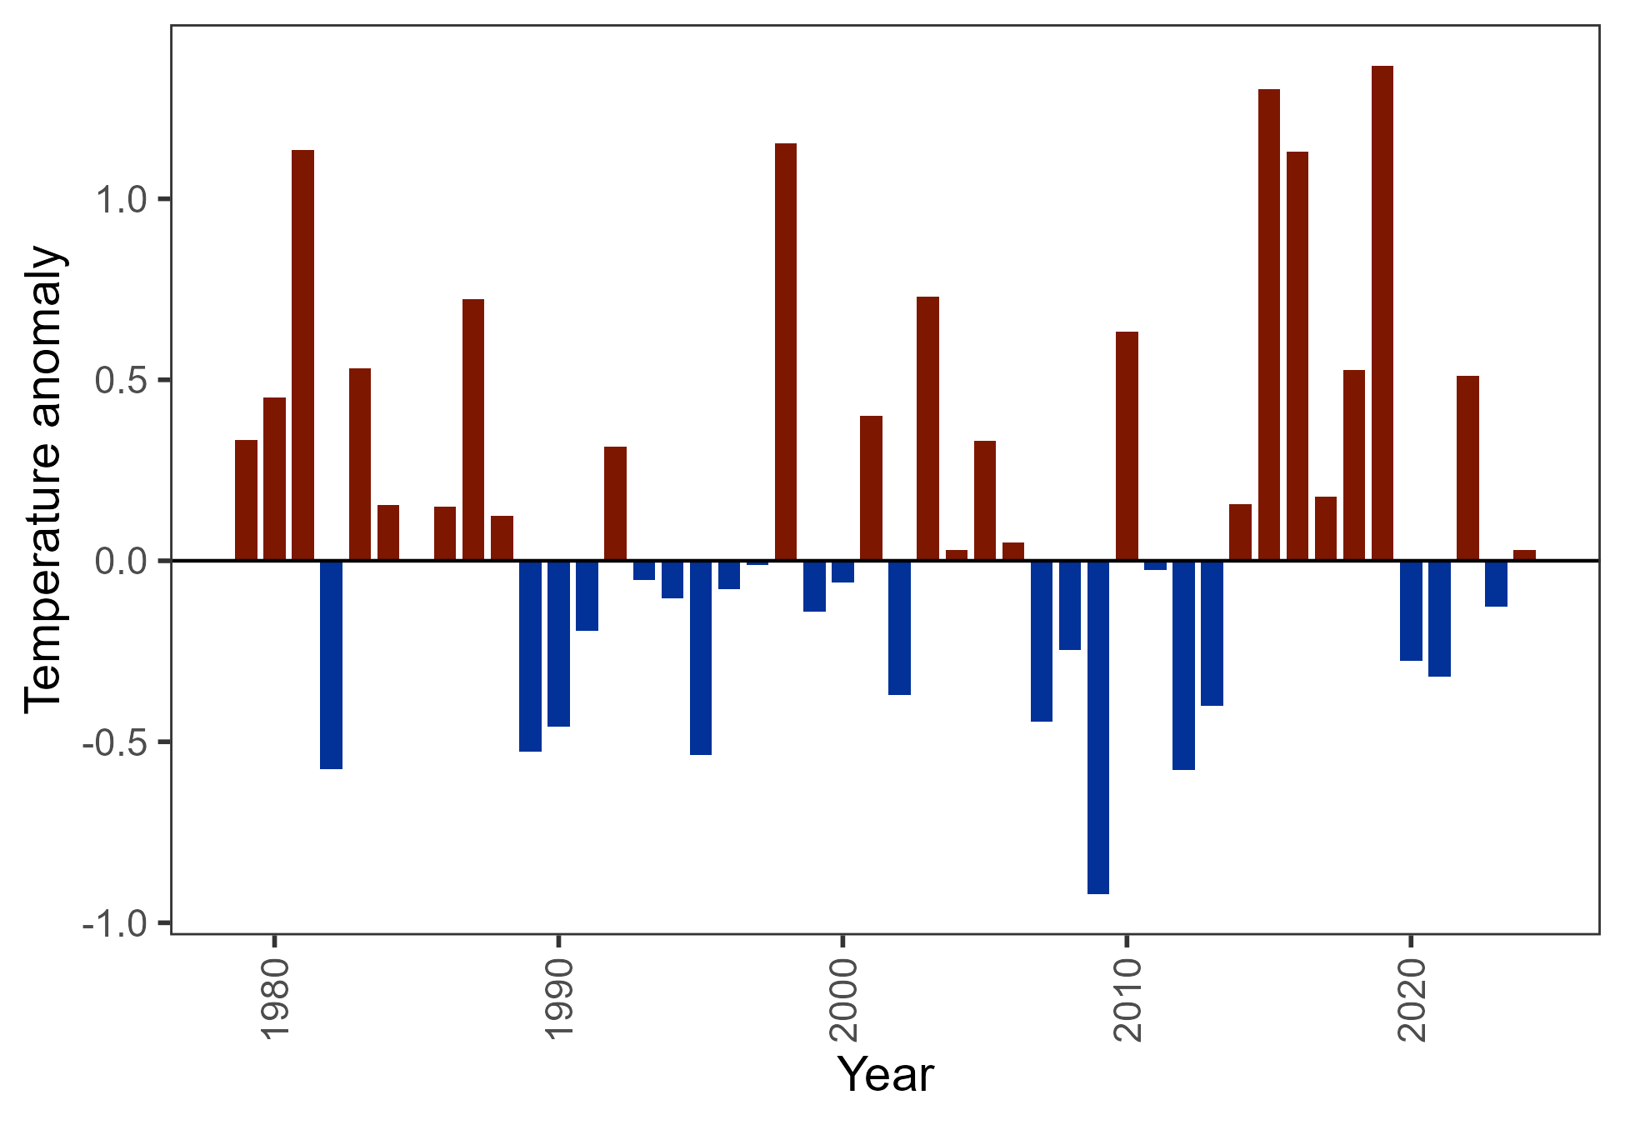
Data – environmental
2025 CFSR not available – covariate not updated (new index will be used in next full assessment)
Warmer bottom temps in bottom trawl survey associated with deeper depth on average

Slide 26
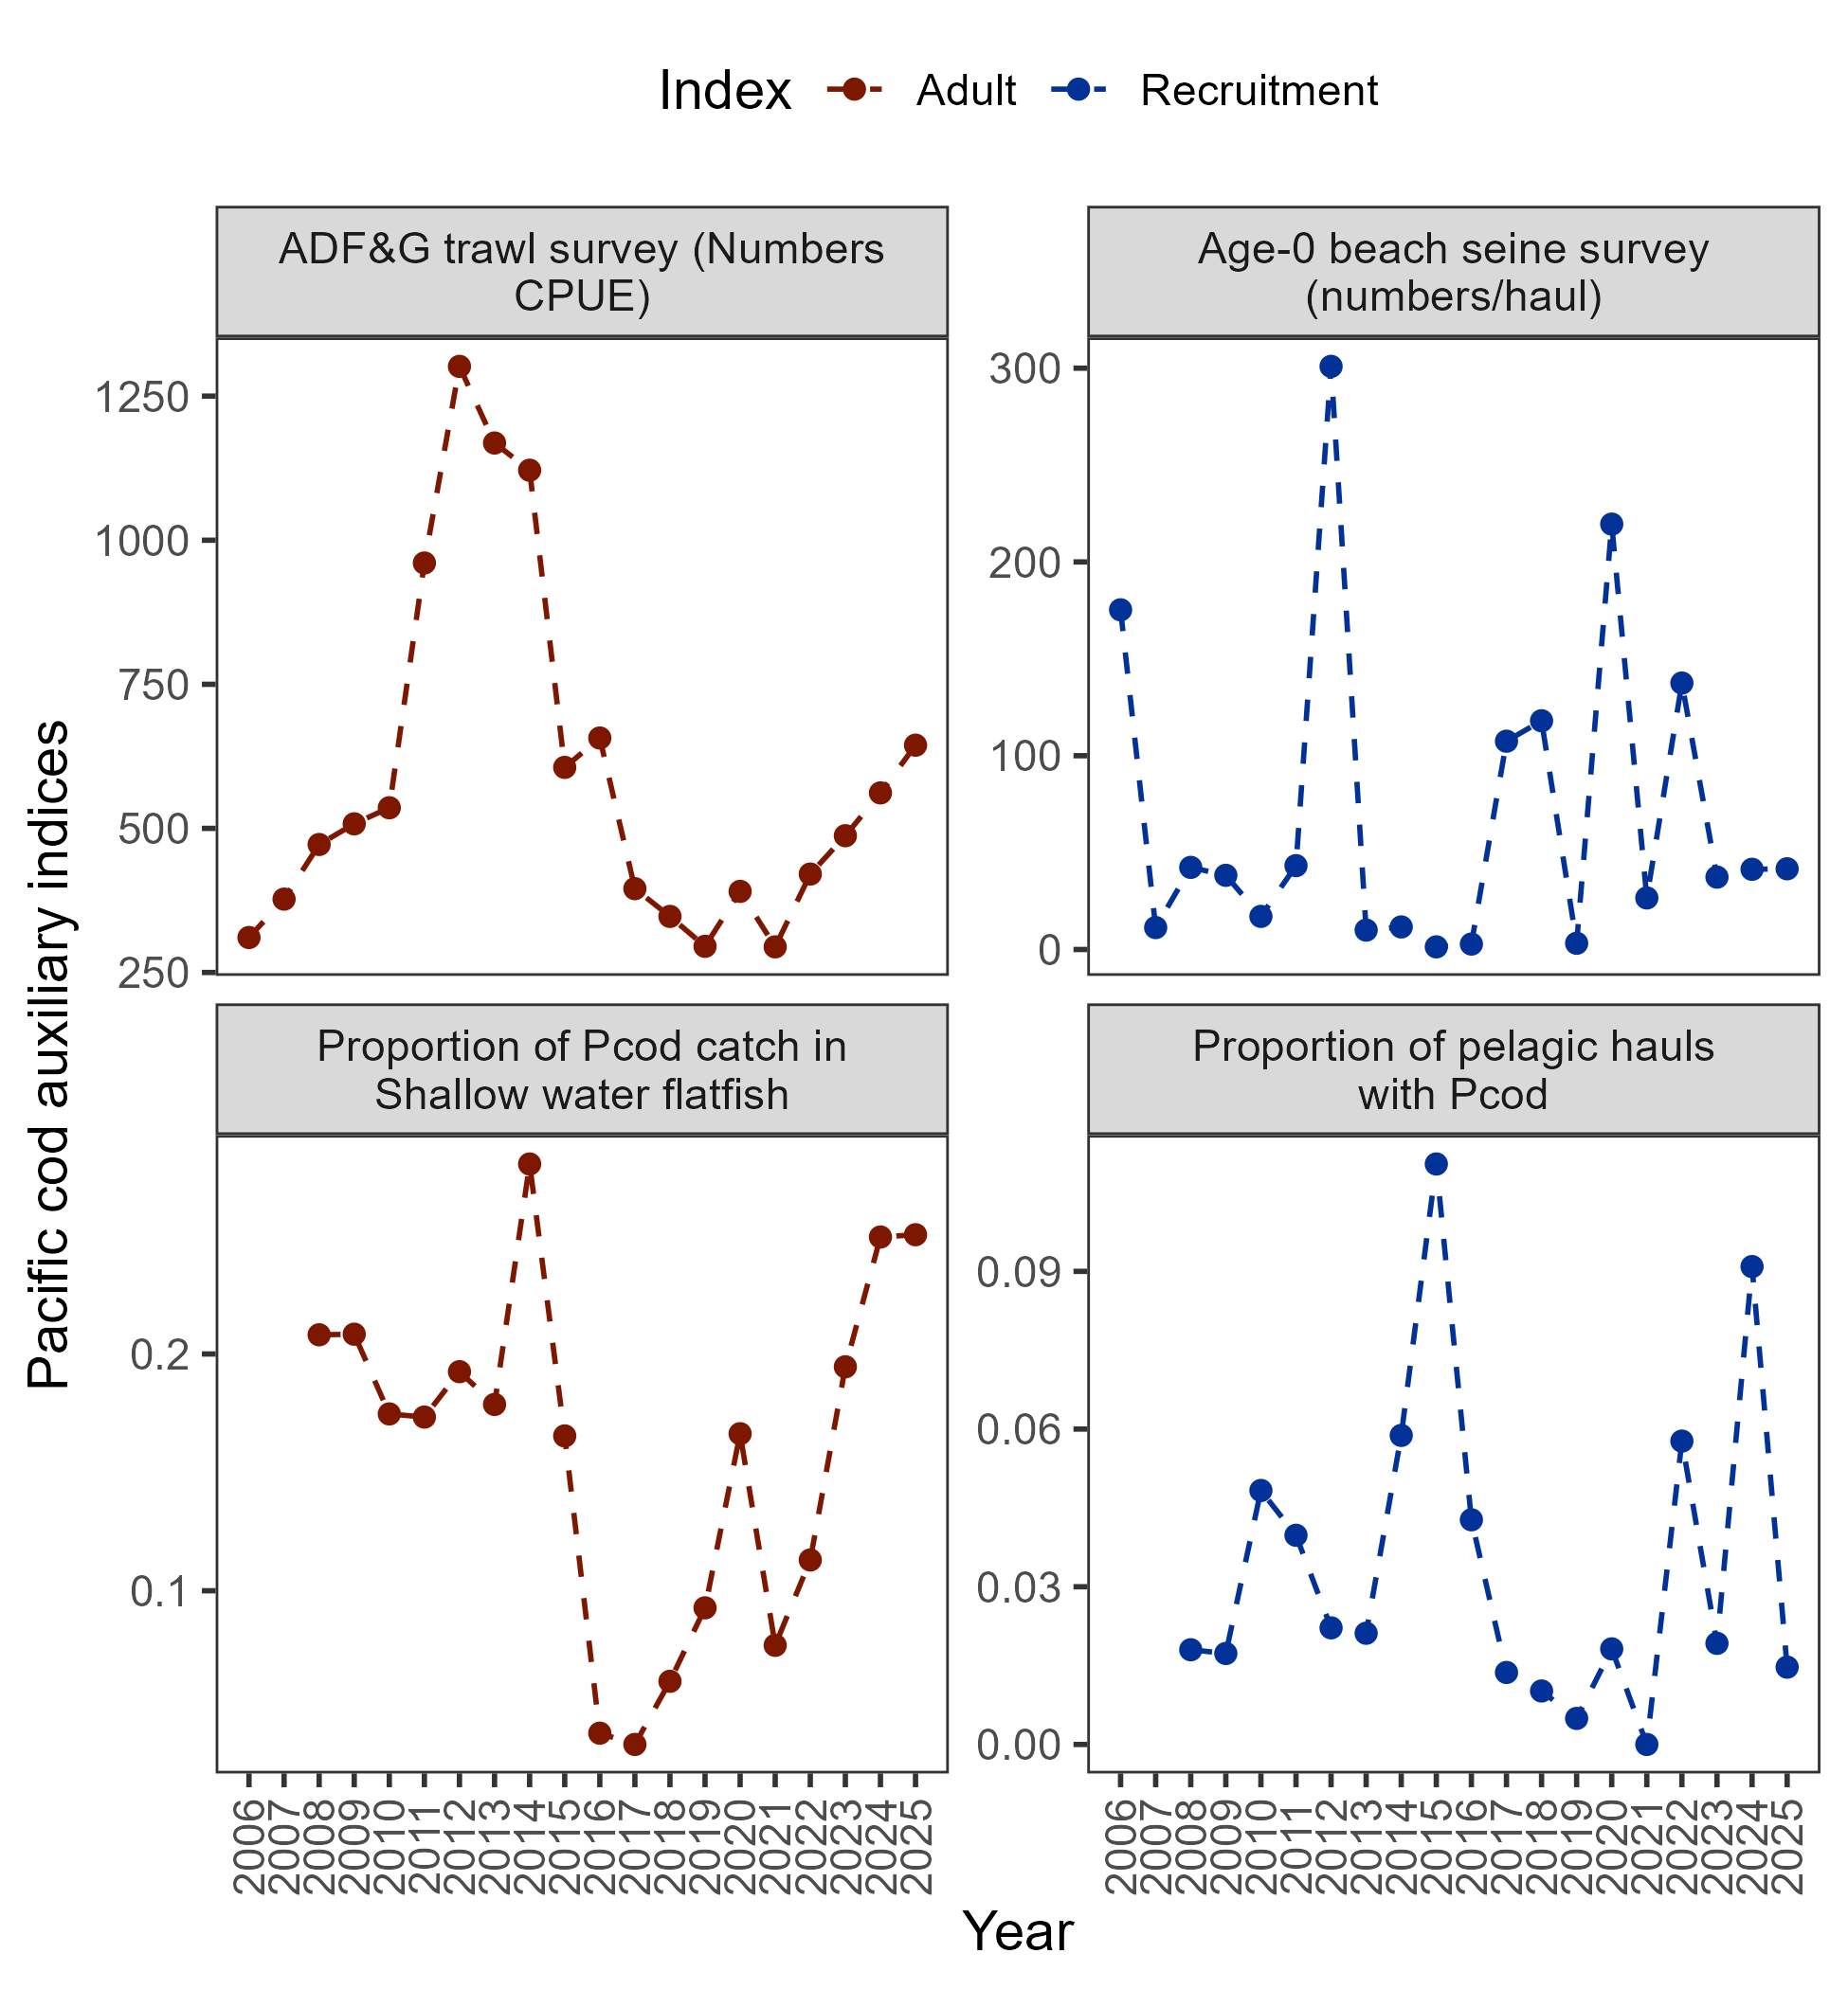
Data – auxiliary information
Adult indices:
ADF&G Numbers CPUE increased
Proportion of cod in SWF catch stayed at >0.2
+14.7%
+0.4%

Slide 27
Data – auxiliary information
Recruitment indices:
Beach seine 2023-2025 below average
2025 below avg in pelagic hauls with cod (age-2)
Both agree with above average 2020 and 2022 year classes
+14.7%
+0.4%

Slide 28
Data – summary
Catch trends:
No red flags
Index trends:
Environmental trends:
2025 warmer than average, cod deeper
General trend is a continued increase in adult population

Slide 29
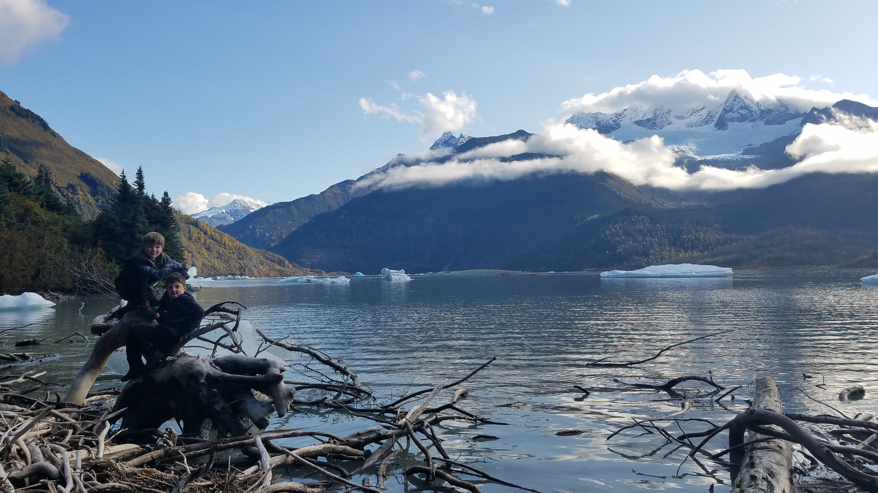
results
Data fits
Model 24.0 results
Model diagnostics
Recommendations

Slide 30
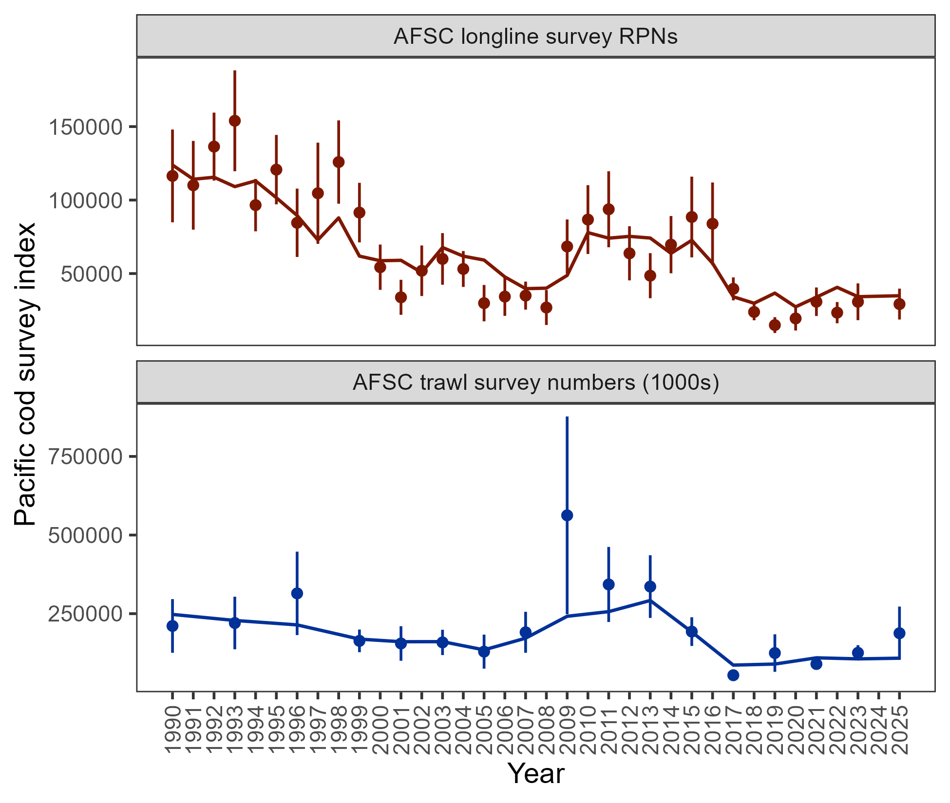

Results: data fits
Pattern of expecting larger RPN from longline survey than observed continues
Model does not fit increase in 2025 trawl survey increase
Model estimates represent balance between fitted indices
Consistent with 2024 assessment

Slide 31
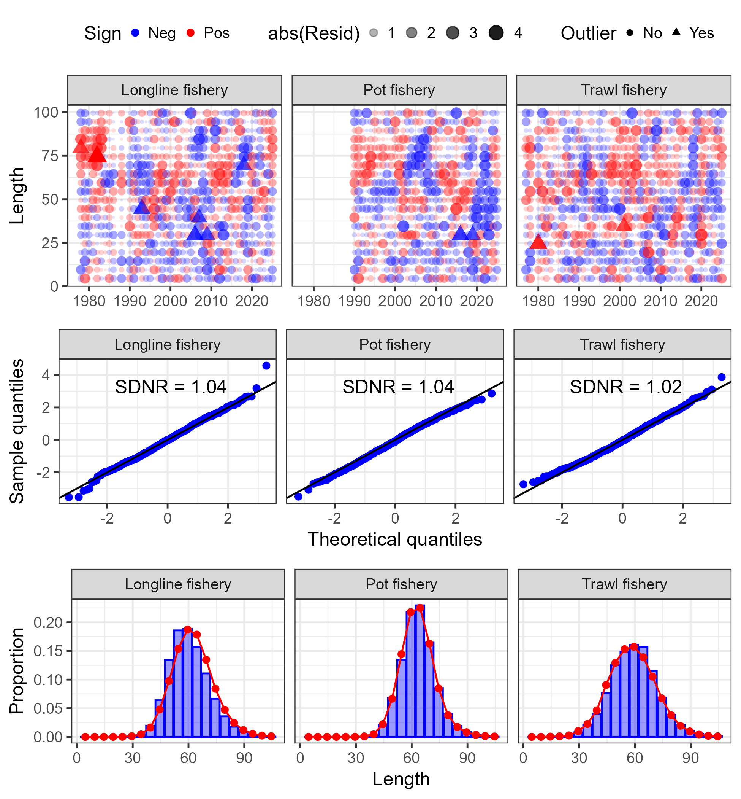
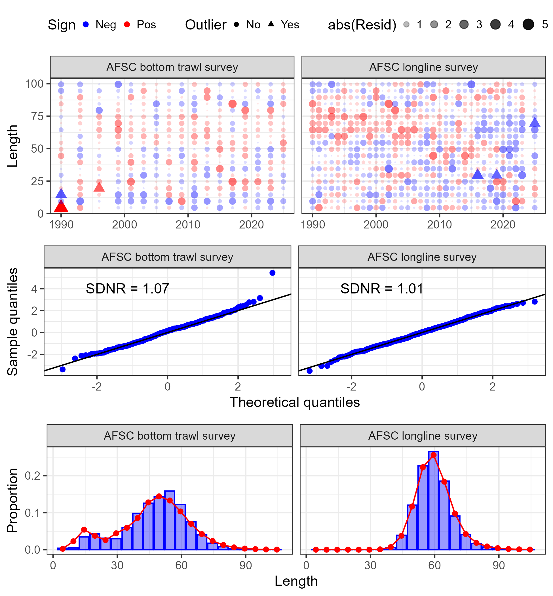
Results: data fits

Slide 32
Presented model diagnostics:
Retrospective: data and model
Convergence diagnostics:
Model convergence: final gradient was 6.45e⁻⁶
Jitter analysis: 50 at 5% CV, 46 converged, 74% to MLE
Other diagnostics available in linked document
Results: diagnostics

Slide 33
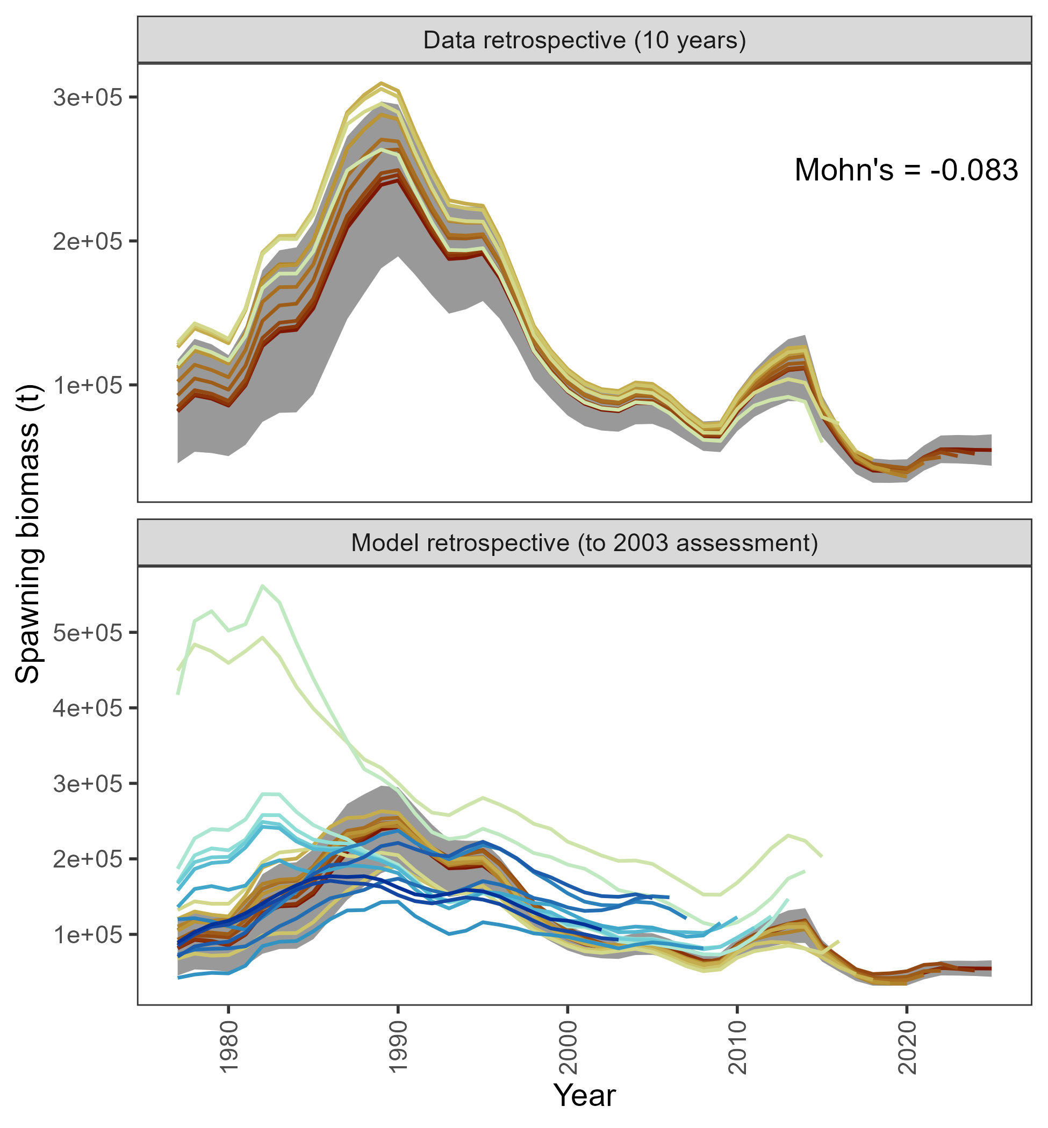
Data retrospective small and negative
Recent model retrospective consistent, but large retrospective pattern across models prior to 2015 assessment
Results: diagnostics

Slide 34
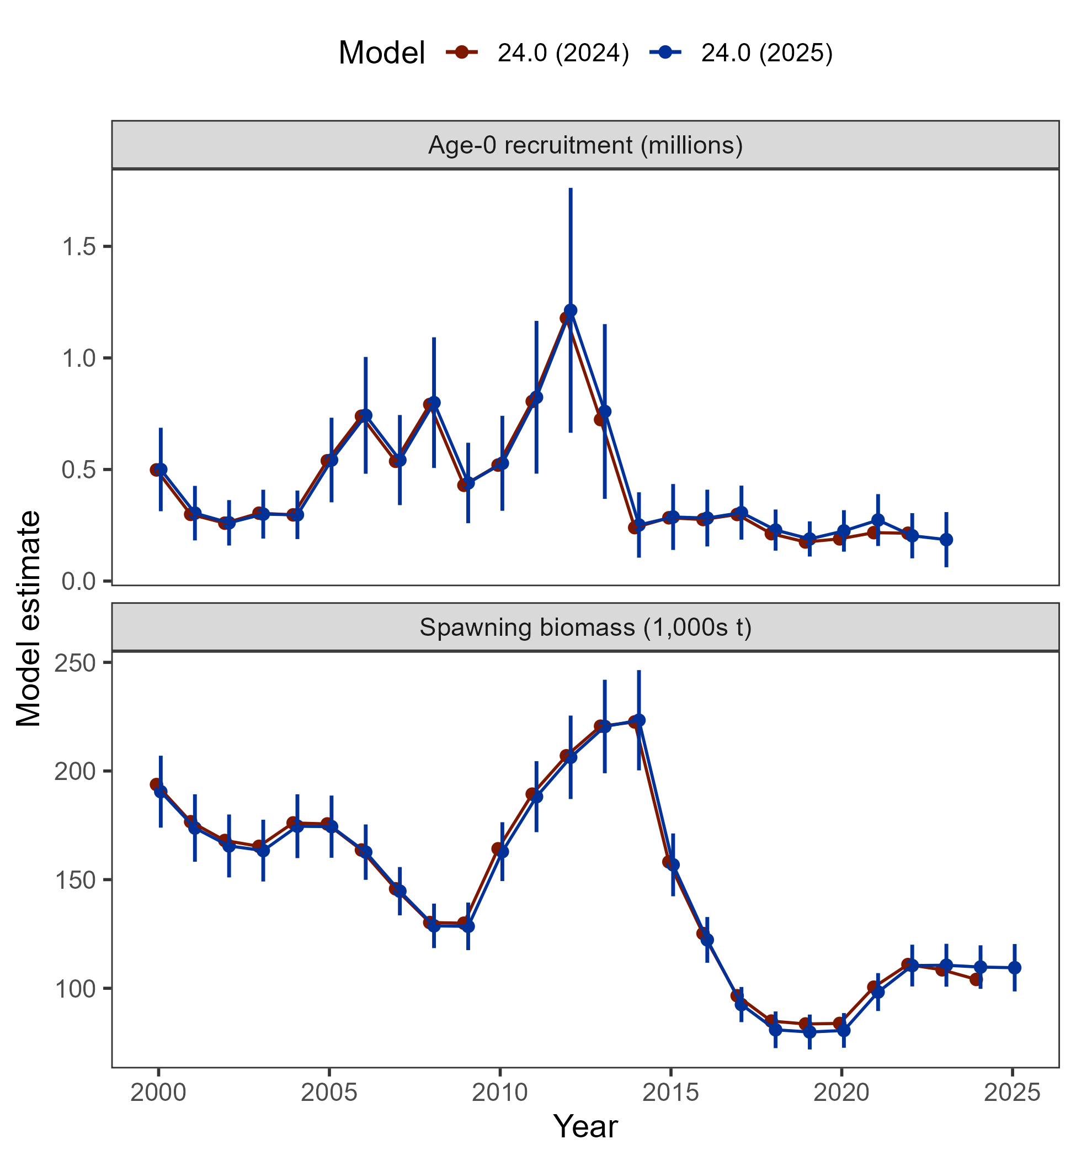
Overall, Model 24.0 in 2025 consistent with all results obtained in 2024
With new data:
Recruitment slightly increases for 2020 and 2021 year classes
Spawning biomass slightly decreases from 2017-2021, then increases after 2022
Results: comparison with 2024

Slide 35
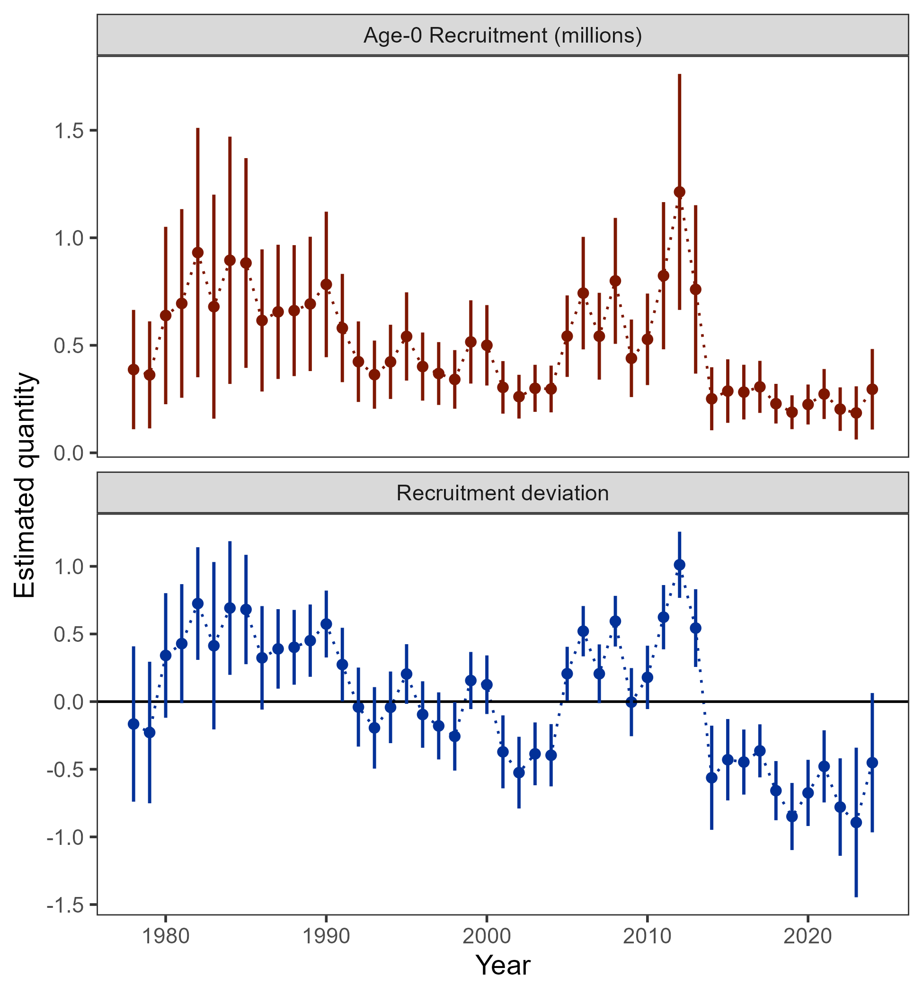
Results: recruitment estimates
Below average recruitment since 2014 (following a stanza of above avg recruitment)

Slide 36
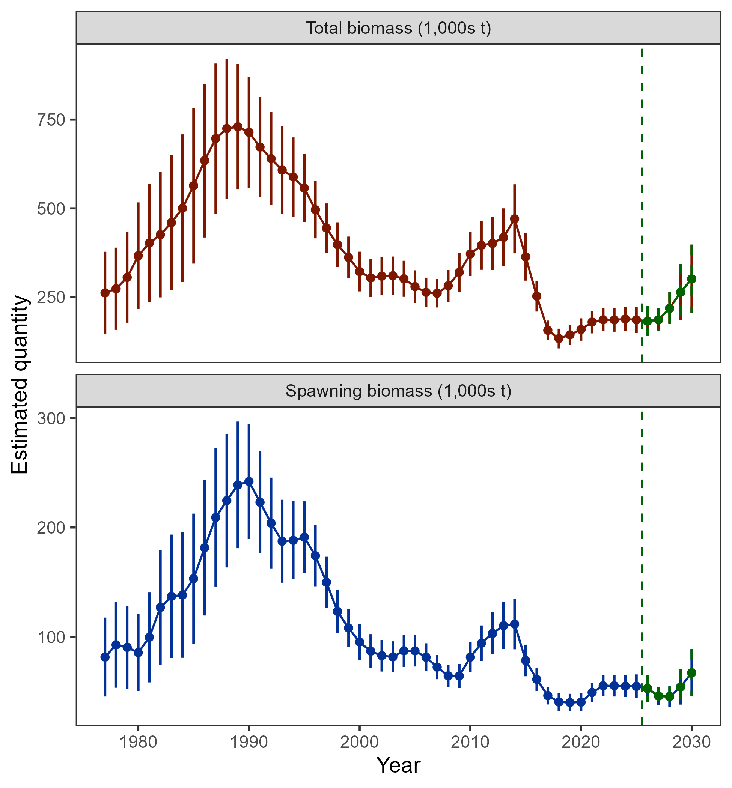
Results: biomass
Biomass projected to increase by 2030, but, based on realization of average recruitment

Slide 37
Stock status
Risk table
ABC/OFL recommendations
Apportionment
Results: recommendations

Slide 38

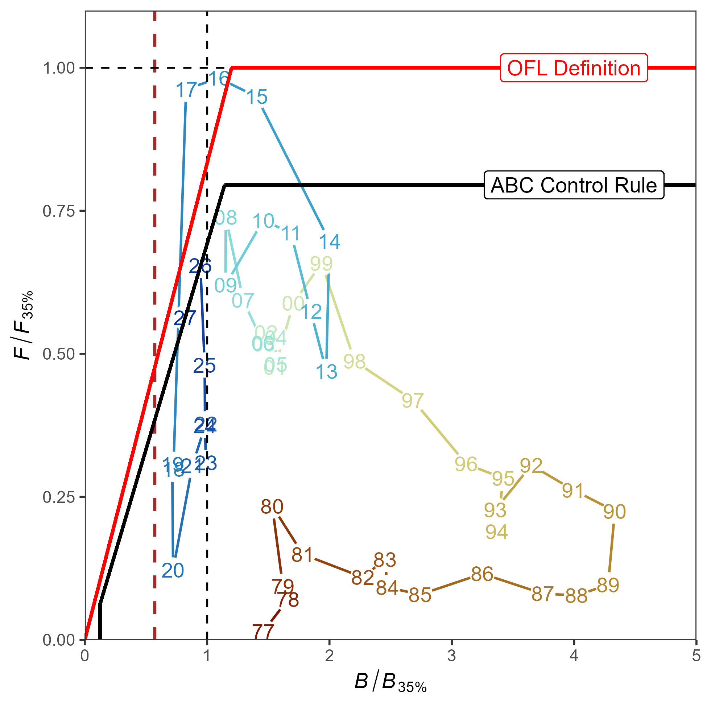
Stock status
Tier 3b: on the ramp
Estimated to be above B_{20%} (dashed red line), 2026 = B_{33.1%}
Projected to move down the ramp in 2027

Slide 39
Risk table
Risk table guiding principle: what are the risks, external to the stock assessment, to the recommended 2026 ABC?

Slide 40
Risk table
Changes from 2024:
Pop’n dynamics considerations: historically low spawning biomass, below average recruitment, and below average spawning conditions in 2025 are cause for concern.
However, our understanding of spawning biomass and recruitment comes from assessment model, which, by definition, includes these considerations in any ABC recommendations
Below average spawning conditions in 2025 will likely lead to poor 2025 year-class, but, this has little effect on 2026 ABC
While there remains concern over the pop’n dynamics of this stock, reduce the risk level to 1 because these risks are not external to the stock assessment

Slide 41
Risk table
Changes from 2024:
Ecosystem considerations: warmer than average ocean conditions in 2025, decrease in adult body condition
Change from risk level 1 to 2 increased concern
Should the 2026 ABC be reduced from maximum?
Given our history with this stock, we must think critically about any recommendations that could have unintended impacts on the stock

Slide 42
Risk table
Should the 2026 ABC be reduced from maximum?
Thinking through this question:
Data synthesis
Model evaluation
Projection considerations
Stock status and HCR
Have we been here before, and, what happened?

Slide 43
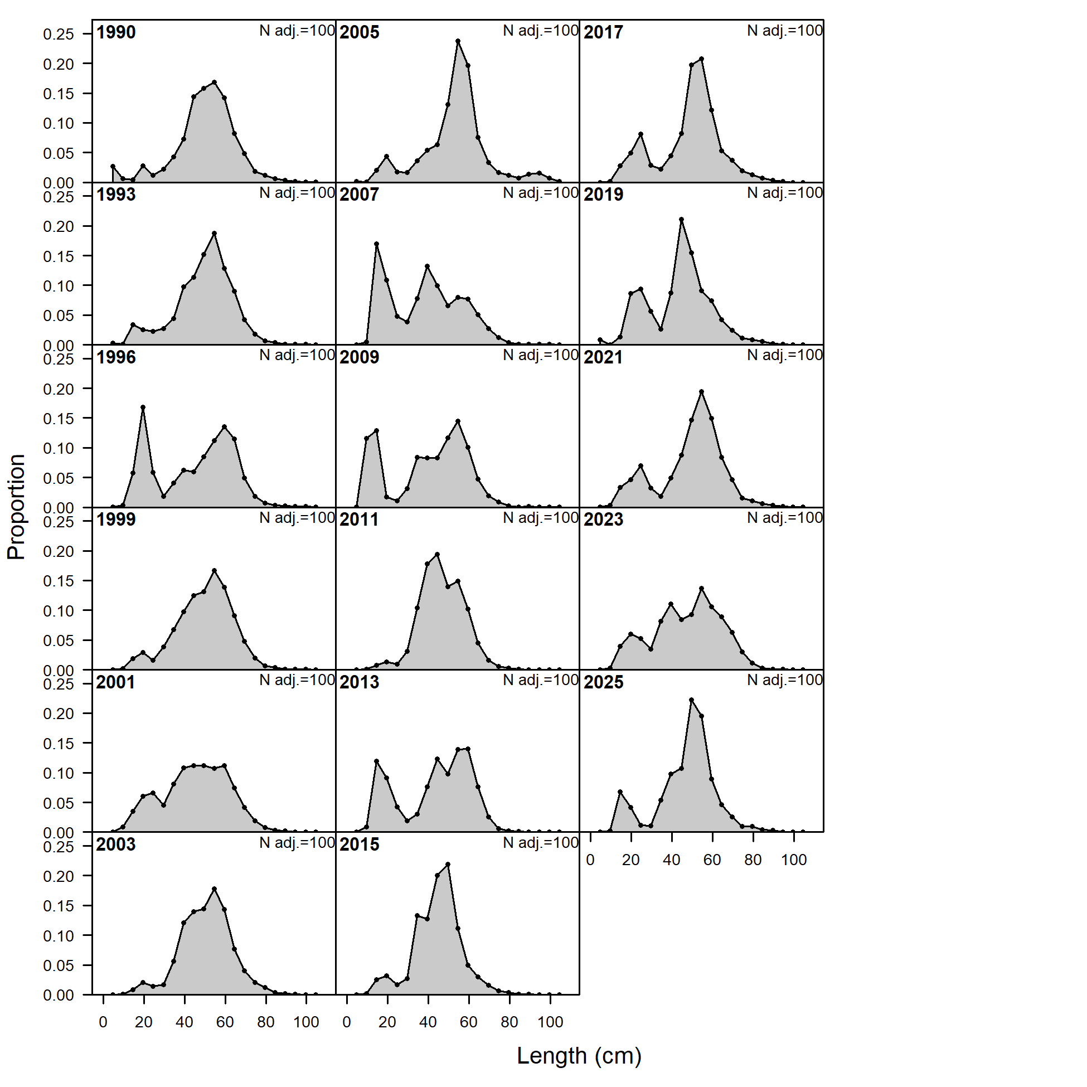
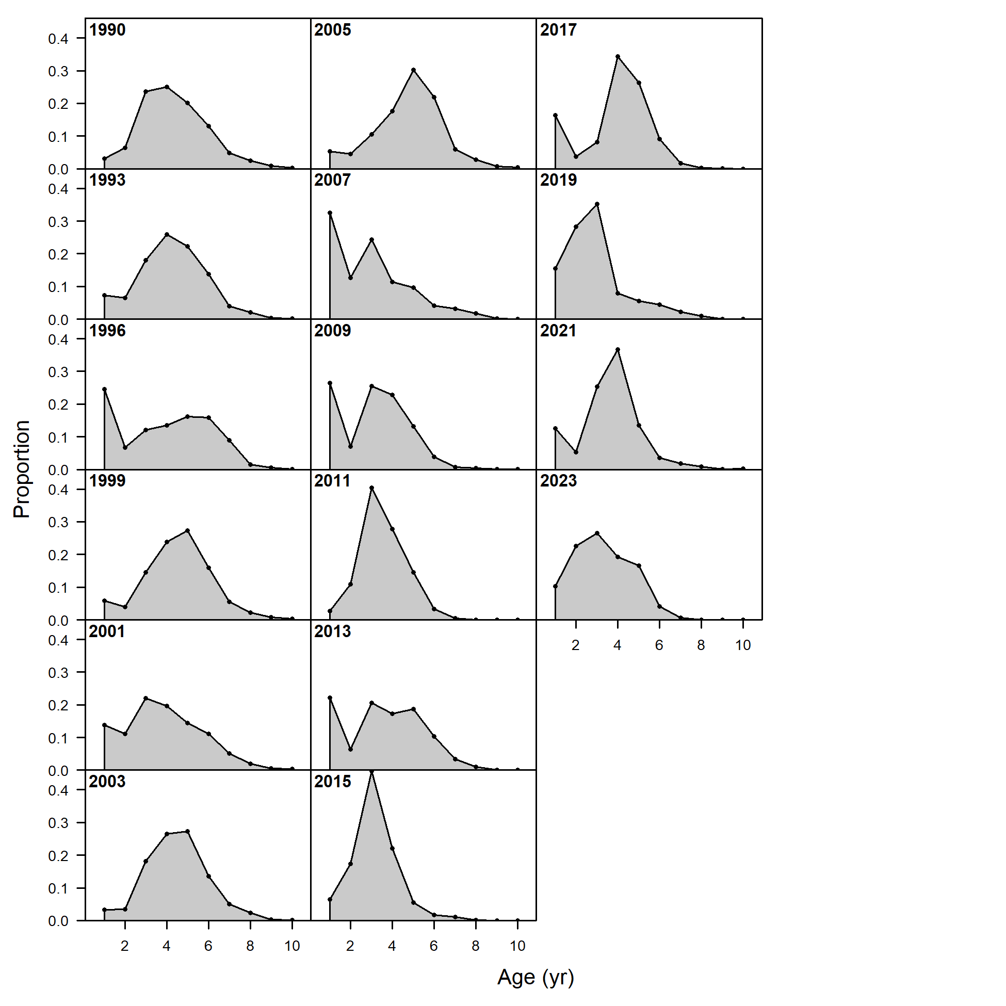
Risk table
Should the 2026 ABC be reduced from maximum?
Data synthesis:
Available population index data indicates an increase in the population since 2023/2024
AFSC longline survey exception, but, we’ve discussed why this result occurred, raw catch rates indicates increase
Available AFSC bottom trawl survey age and length composition consistently indicates age-1 – age-3 fish in population

Slide 44
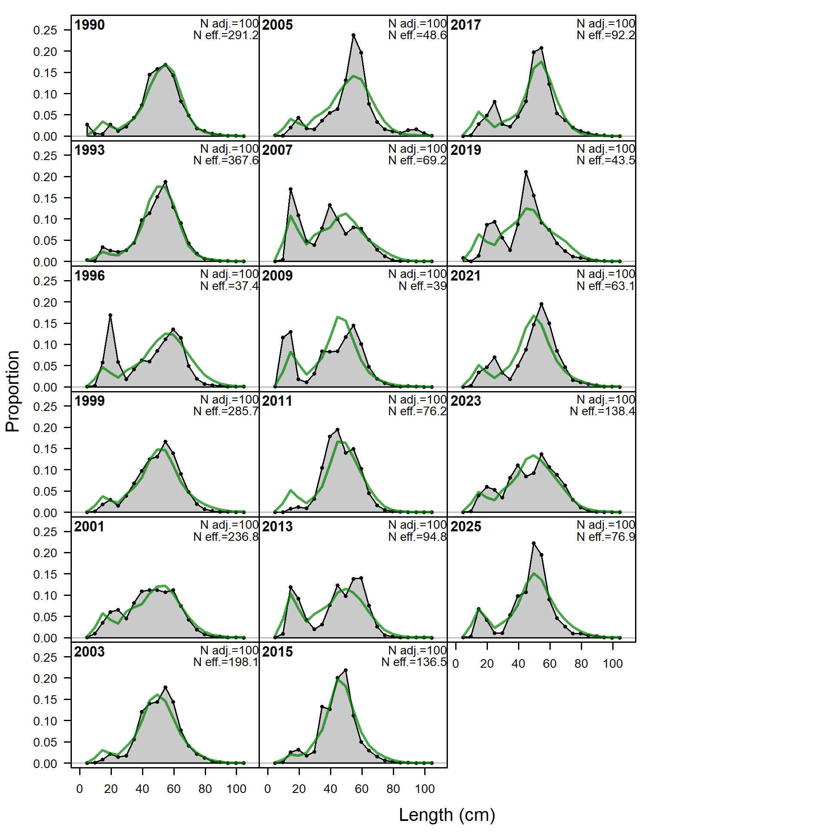
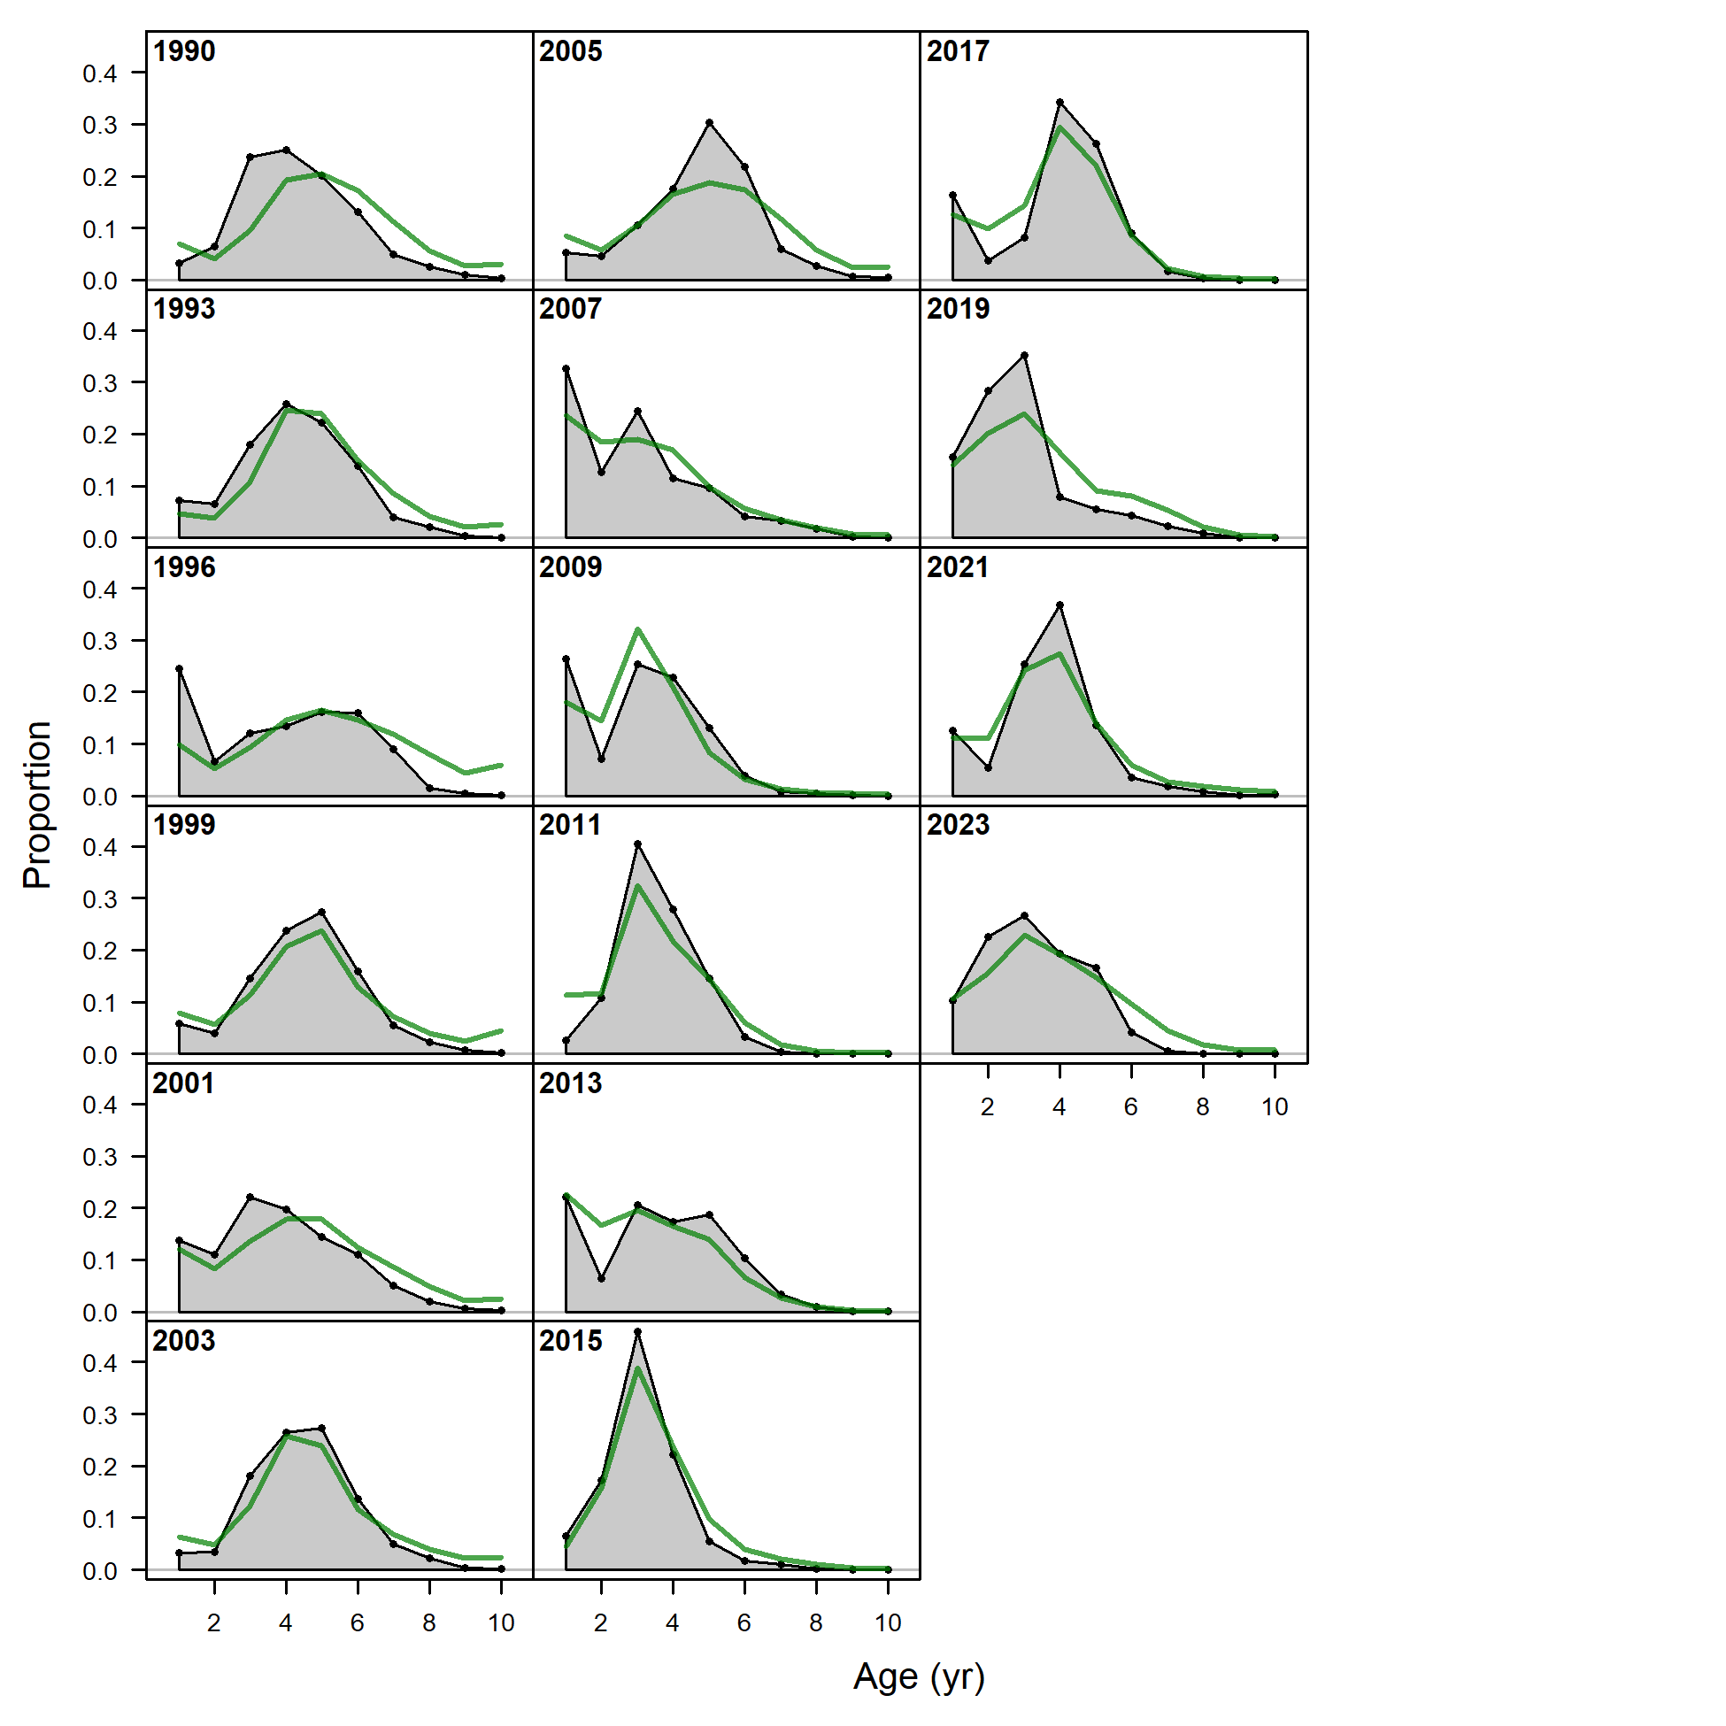
Risk table
Should the 2026 ABC be reduced from maximum?
Model evaluation:
Model continues to estimate below average recruitment, but, these estimates do not fit the observed data well, particularly for smaller/younger fish
There is a possibility that the model estimates are misrepresenting recruitment
Model does not reflect increase in AFSC bottom trawl survey

Slide 45
Risk table
Should the 2026 ABC be reduced from maximum?
Projection considerations:
Continue to note the average recruitment concern in projected biomass, when recent recruitment estimated to be below average since 2014; this potentially results in overly-optimistic long-term projections, but does not have large effect on 2026 ABC
Assumption of utilizing full ABC in terminal year of model for projections reduces 2026 recommended ABC by 5% as compared to using observed catch proportions since fishery closure in 2020

Slide 46
Risk table
Should the 2026 ABC be reduced from maximum?
Stock status and HCR:
Stock is currently in Tier 3b, on the ramp of the HCR
Based on the HCR and projected stock status, F_{40%} reduced by 18% to obtain 2026 F_{ABC}

Slide 47
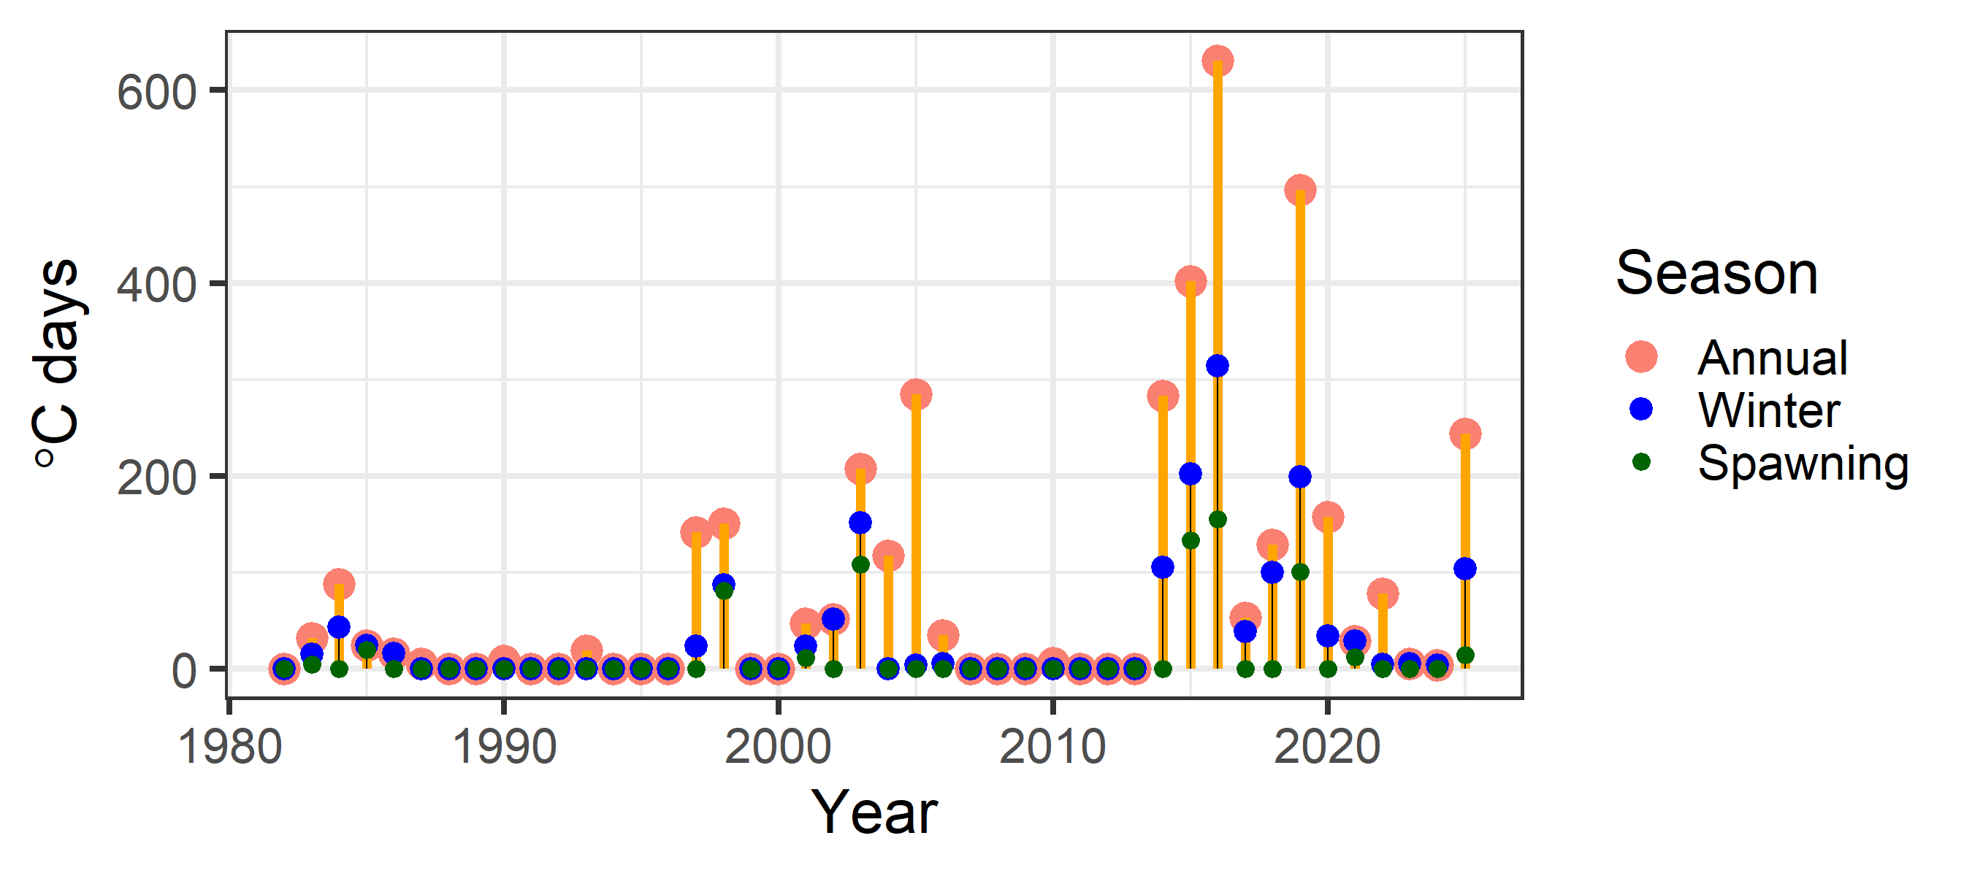
Risk table
Should the 2026 ABC be reduced from maximum?
Have we been here before, and, what happened?
Recognizing that no two years are exactly the same, highlight two recent years in which number of heatwave days similar to 2025: 2014 and 2019

Slide 48
Risk table
Have we been here before, and, what happened?
2014: precipitated severe heatwave in 2015 and 2016, following which population collapses
Model estimates from 2014/2015 much different than current model
Spawning biomass in 2014 250% larger than Model 24.0 2014 estimate
Adopted 2015 ABC 150% larger than recommended 2026 ABC
Standardizing ABC as a proportion of total biomass and comparing between 2015 and 2026, recommended 2026 ABC 24% smaller than what was adopted in 2015
Seasonality and selectivity is the primary difference between the model used in 2014 and Model 24.0

Slide 49
Risk table
Have we been here before, and, what happened?
2019: Model recommendation in 2019 resulted in 2020 fishery closure
After 2019, survey indices have increased, presumably reflecting advantageous conditions for cod population due to improvement in ecosystem conditions after 2019
2019 year-class estimated to be smallest in time-series, suspect that 2025 year-class could be of similar magnitude
While a number of improvements to the model and data have been implemented since 2019, Model 24.0 is fundamentally the same model as used in 2019 to recommend the fishery closure (note: no additional buffers have been applied to recommended ABC since fishery closure)

Slide 50
Risk table
Have we been here before, and, what happened?
 | 2014 | 2019 | 2025
Biomass conditions | Largest biomass in recent time series | Lowest biomass in time series | Continuing to increase since historical low
Recruitment trends | At end of period of above average recruitment | In midst of below average recruitment | 10 years worth of below average recruitment
Demographics (survey length)

Slide 51
Risk table
Should the 2026 ABC be reduced from maximum?
Summary: There are several aspects of the current stock assessment that mitigate risk, including catch assumptions in projections, stock status and the HCR, and model development over time
But, do these serve to mitigate the risk identified for the 2026 ABC?
It is not clear to what extent increased risk highlighted in 2025 is mitigated by stock assessment
It remains unknown if environmental conditions in 2025 will persist into 2026, and whether they had significant impact on the GOA cod stock

Slide 52
Risk table
Should the 2026 ABC be reduced from maximum?
An additional buffer to the 2026 ABC could be considered, however,
There is no quantitative method available with clear objectives from which to derive the additional buffer, it remains a subjective decision
There is no understanding of any measurable risk reductions that have occurred due to buffers that have been implemented across stocks to inform the magnitude of buffers

Slide 53
Risk table
Should the 2026 ABC be reduced from maximum?
Taken together, a reduction from maximum ABC in 2026 is not recommended, while at the same time acknowledge the increased risk associated with this recommendation

Slide 54
ABC/OFL recommendations
Model 24.0 recommended ABC: 29% increase in 2026 ABC
Quantity | As estimated or specified last year for: |  | As estimated or specified this year for:
 | 2025 | 2026 | 2026 | 2027
M (natural mortality rate) | 0.49* | 0.49* | 0.5* | 0.5*
Tier | 3b | 3b | 3b | 3b
Projected total (age 0+) biomass (t) | 177,497 | 200,521 | 182,156 | 186,118
Female spawning biomass (t)
Projected | 46,920 | 44,674 | 52,772 | 45,838
B_{100%} | 163,585 | 163,585 | 159,595 | 159,595
B_{40%} | 65,434 | 65,434 | 63,838 | 63,838
B_{35%} | 57,255 | 57,255 | 55,858 | 55,858
F_{OFL} | 0.57 | 0.51 | 0.68 | 0.54
maxF_{ABC} | 0.46 | 0.43 | 0.54 | 0.47
F_{ABC} | 0.46 | 0.43 | 0.54 | 0.47
OFL (t) | 38,688 | 33,099 | 49,782 | 38,812
maxABC (t) | 32,141 | 30,193 | 41,520 | 32,209
ABC (t) | 32,141 | 30,193 | 41,520 | 32,209
Status | As determined last year for: |  | As determined this year for:
 | 2023 | 2024 | 2024 | 2025
Overfishing | No | n/a | No | n/a
Overfished | n/a | No | n/a | No
Approaching overfished | n/a | No | n/a | No

Slide 55

apportionment
Two REMA model configuration changes recommended for GOA Biologically informed Recommended Distributions (BRD)
Estimate single process error parameter across GOA subregions
Estimate additional observation error parameter for GOA bottom trawl survey
These REMA model configurations previous adopted for GOA Thornyhead stock complex (Echave et al. 2022, Siwicke et al. 2024)

Slide 56
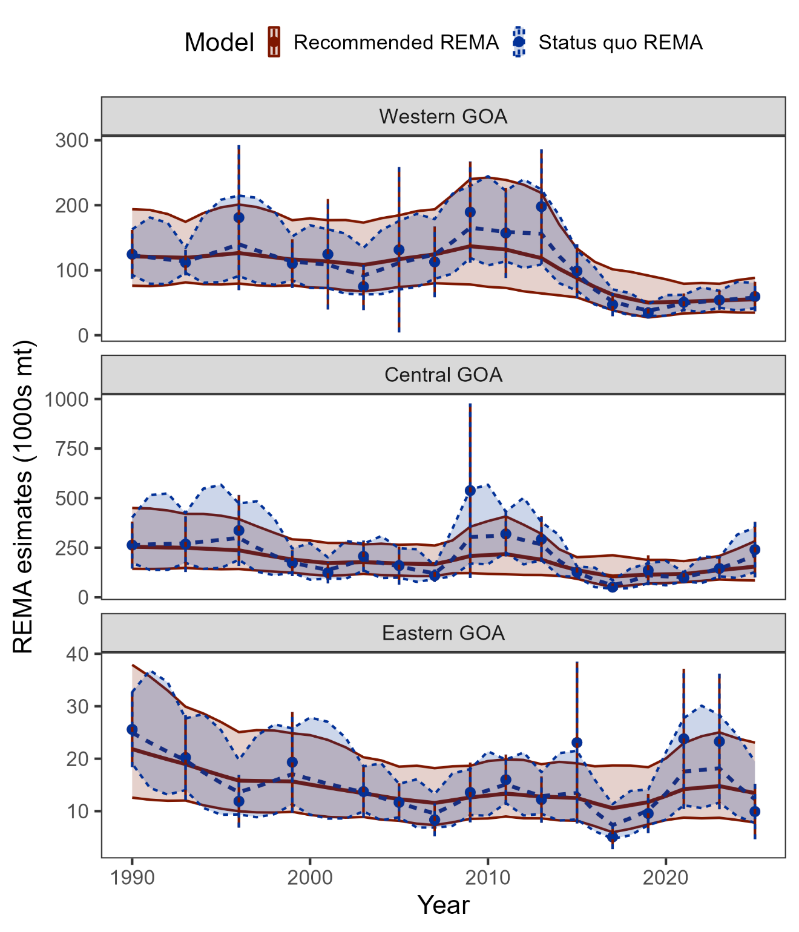
apportionment
Recommended REMA configuration changes serve to:
Smooth estimates of subregion biomass and uncertainty that is reflective of primary assessment model estimates of biomass,
Provide apportionment estimates that do not result in drastic and improbable shifts in distribution that are inconsistent with our understanding of cod life history and movement

Slide 57
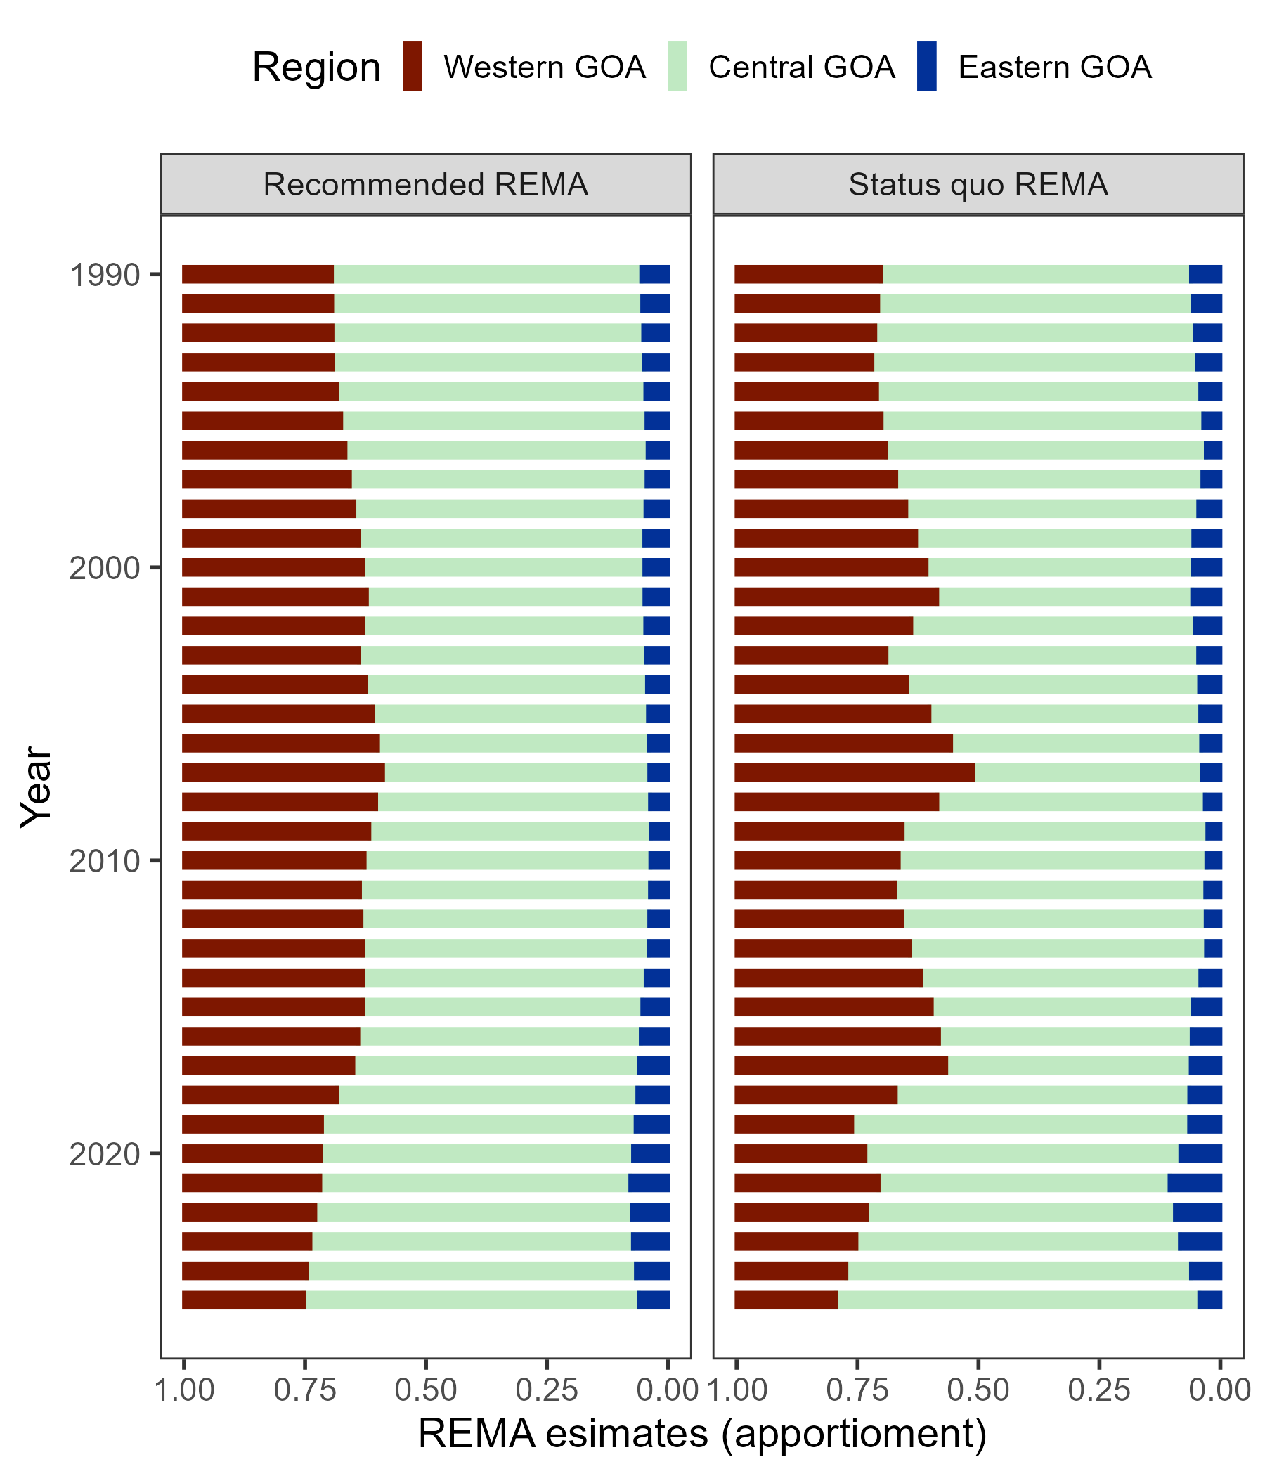
apportionment
Recommended REMA configuration changes serve to:
Smooth estimates of subregion biomass and uncertainty that is reflective of primary assessment model estimates of biomass,
Provide apportionment estimates that do not result in drastic and improbable shifts in distribution that are inconsistent with our understanding of cod life history and movement

Slide 58
apportionment
Comparison among adopted BRDs from 2025, BRDs from status quo REMA model, and BRDs from recommended REMA model:
2-year projected BRDs from recommended REMA model
 | Western | Central | Eastern | Total
Previous apportionment | 27.1% | 63.8% | 9.1% | 100%
2025 BRD | 8,710 | 20,506 | 2,925 | 32,141
Status quo apportionment | 20.6% | 75.1% | 4.3% | 100%
2026 BRD | 8,553 | 31,182 | 1,785 | 41,520
Recommended apportionment | 24.8% | 69.2% | 6% | 100%
2026 BRD | 10,297 | 28,732 | 2,491 | 41,520
 | Western | Central | Eastern | Total
Area apportionment | 24.8% | 69.2% | 6% | 100%
2026 BRD | 10,297 | 28,732 | 2,491 | 41,520
2027 BRD | 7,987 | 22,289 | 1,933 | 32,209

Slide 59
Questions?

